Slide 1
Pediatric Trauma Resources:
Chest, Abdomen, and Pelvis
Disclaimer: This guideline is designed for general use with most patients; providers should use their independent clinical judgment. This guideline is not intended to be a substitute for professional medical advice, diagnosis, or treatment.

Slide 2
Disclaimers
MMRTAC makes no representations or warranties about the accuracy, reliability, or completeness of the content. Content is provided “as is” and is for informational use only. It is not a substitute for professional medical advice, diagnosis, or treatment. MMRTAC disclaims all warranties, express or implied, statutory or otherwise, including without limitation the implied warranties of merchantability, non-infringement of third parties’ rights, and fitness for a particular purpose.
This content was developed to guide general patient care and may not be suitable for use in all patient care environments. MMRTAC does not endorse, certify, or assess third parties’ competency. You hold all responsibility for your use or nonuse of the content. MMRTAC shall not be liable for claims, losses, or damages arising from or related to any use or misuse of the content.

Slide 3
Contents
Topic | Page
Definitions | 4
Thoracic CT Rarely Indicated in Children | 5
Chest Wall Injuries | 6
Isolated Sternal and Scapular Fractures | 7
TEN-4-FACESp: Patterned Skin Injuries and Unusual Locations of Injuries | 8
Evaluation of Abdominal Trauma in Child Physical Abuse | 9
Features Associated with Child Abuse Identified in Initial Trauma Evaluation | 10
Pediatric Blunt Chest Injury Guideline | 11
Pediatric Thoracolumbar Spine Evaluation Clinical Guideline | 12
Pediatric Thoracolumbar Spine Evaluation: Spinal Precautions Logroll Guidelines | 13
Tools for Determining Need for Abdominal CT in Children with Blunt Abdominal Trauma | 14
Nonoperative Management of Blunt Liver and Spleen Injuries: ATOMAC Guideline | 15
Pediatric Isolated Blunt Abdominal Injury Clinical Guideline | 16
Pediatric Pancreatic Injury | 17
Guideline for Nonoperative Management of Pediatric Pancreatic Injuries | 18
Diagnosis, Evaluation and Management of Hollow Viscus Injuries in Children | 19
Pediatric Blunt Urological Injuries | 20
Pediatric Gynecological Injuries | 21
Disclaimer: This guideline is designed for general use with most patients; providers should use their independent clinical judgment. This guideline is not intended to be a substitute for professional medical advice, diagnosis, or treatment.

Slide 4
Definitions for this Resource
Neonate: a newborn less than 30 days after birth
Infant: a newborn ages 1-12 months
Pediatric: a child ages 1-14 years; a child who has not yet undergone puberty.
Note: The guidelines and information included in this resource may also apply to children ages 15-17 years of age and/or those who have undergone puberty, based on clinician discretion.
Exposure to radiation through imaging studies or procedures should be limited to the extent possible for all children <18 years of age.
Clinical approach for all children <18 years of age must be developmentally appropriate based on the child’s current developmental stage, which may or may not correlate with physical age.
Disclaimer: This guideline is designed for general use with most patients; providers should use their independent clinical judgment. This guideline is not intended to be a substitute for professional medical advice, diagnosis, or treatment.
Reviewed August 2023

Slide 5
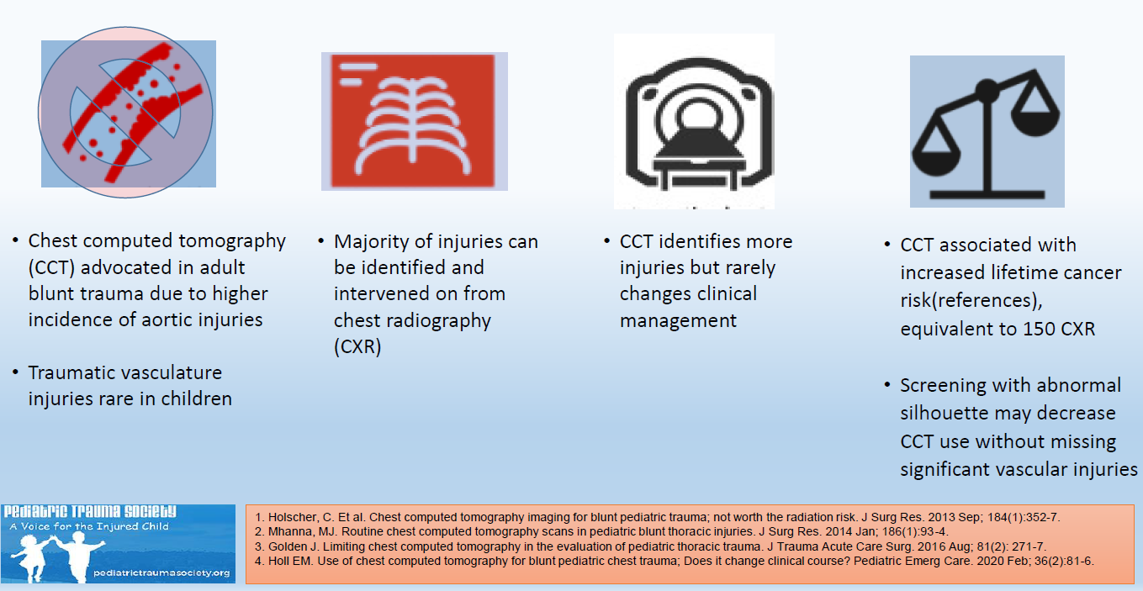
Thoracic CT Rarely Indicated in Children
Additional information is available on the Pediatric Trauma Society Guidelines Hub: https://pediatrictraumasociety.org/resources/guidelines/?s=section&amp;sID=chest
Disclaimer: This guideline is designed for general use with most patients; providers should use their independent clinical judgment. This guideline is not intended to be a substitute for professional medical advice, diagnosis, or treatment.

Slide 6
Chest Wall Injuries
Rib Fractures
Children < 3 years of age with rib fractures and without a history of high-force trauma warrant evaluation for physical child abuse
Posterior rib fractures in young children without history of high-force trauma are highly concerning for physical child abuse
Children with multiple rib fractures warrant admission to a pediatric trauma center for pain control, age-appropriate pulmonary physiotherapy
Flail Chest
Require respiratory support
Intubation and positive-pressure ventilation needed for children with respiratory distress or failure
Disclaimer: This guideline is designed for general use with most patients; providers should use their independent clinical judgment. This guideline is not intended to be a substitute for professional medical advice, diagnosis, or treatment.
Reviewed August 2023

Slide 7
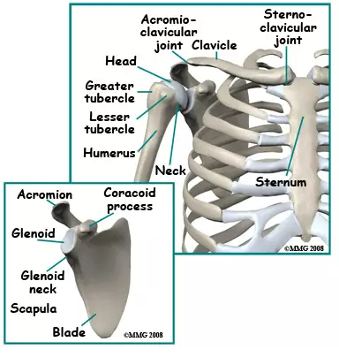
Isolated Sternal Fractures
ECG and cardiac monitoring warranted in patients with blunt cardiac injury or sternal fracture
Computed tomography angiography (CTA) is recommended in patients with suspected posterior sternoclavicular fractures or dislocations
Can be managed as outpatient if ECG and chest imaging are normal, patient is comfortable
Admission at a pediatric trauma center is warranted for children who require more aggressive pain control or have associated injuries
https://www.evidencesportandspinal.com/Injuries-Conditions/Shoulder/Shoulder-Issues/Adult-Shoulder-Fractures/a~3803/article.html
Scapular Fractures
Most children with scapular fractures have serious injuries that require admission at a pediatric trauma center
Non-displaced or minimally displaced scapular fractures can often be treated non-surgically with a sling due to the number of muscle attachments supporting the scapula
Displaced fractures of the scapular neck, and displaced glenoid fractures may require open reduction
Disclaimer: This guideline is designed for general use with most patients; providers should use their independent clinical judgment. This guideline is not intended to be a substitute for professional medical advice, diagnosis, or treatment.

Slide 8
Reference: Pierce MC, Magana JM, Kaczor K, Lorenz DJ, Meyer G, Bennett, BL, Kanegaye JT. The prevalence of bruising among infants in pediatric emergency departments. Ann Emerg Med 2016;67:1-8. doi: 10.1016/j.annemergmed.2015.06.021 PMID: 26233923
Disclaimer: This guideline is designed for general use with most patients; providers should use their independent clinical judgment. This guideline is not intended to be a substitute for professional medical advice, diagnosis, or treatment.

Slide 9
References:
https://childprotection.rcpch.ac.uk/child-protection-evidence/visceral-injuries-systematic-review/
https://www.facs.org//media/files/qualityprograms/trauma/tqip/abuse_guidelines.ashx
Disclaimer: This guideline is designed for general use with most patients; providers should use their independent clinical judgment. This guideline is not intended to be a substitute for professional medical advice, diagnosis, or treatment.

Slide 10
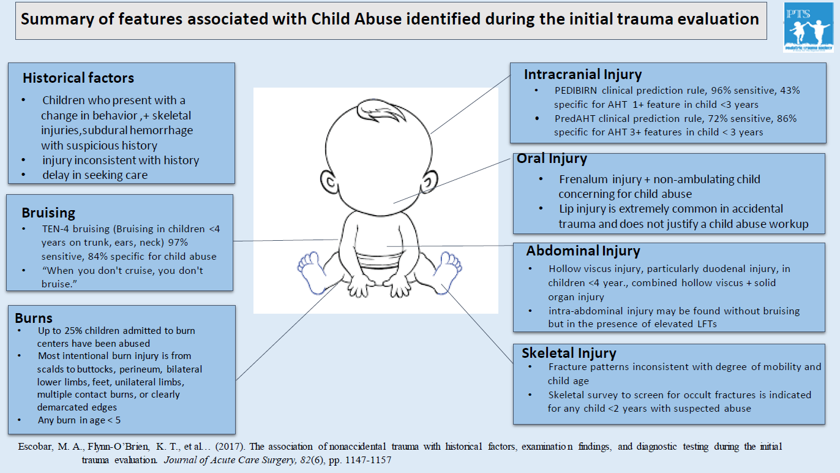
Reference: Pediatric Trauma Society. https://pediatrictraumasociety.org/multimedia/files/guidelines/Summary-of-features-Abstract.pdf
Disclaimer: This guideline is designed for general use with most patients; providers should use their independent clinical judgment. This guideline is not intended to be a substitute for professional medical advice, diagnosis, or treatment.

Slide 11
Pediatric Blunt Chest Injury Guideline
Clinical Assessment Findings:
Abnormal respiratory rate
SpO2 <90%
Chest wall tenderness
Chest wall crepitus
Abnormal breath sounds
Dyspnea
Chest pain
Seat belt sign
Ecchymosis on the chest
Manage potential or recognized airway obstruction
Support ventilation and oxygenation as required
Treat significant pneumothoraces or hemothoraces
AP Chest X-ray
No
Unremarkable x-ray?
Yes
Any of these present:
Widened mediastinum
Bilateral rib fractures
Hemothorax
Ruptured diaphragm
Tracheal injury
Unresolved pneumothorax despite chest tube
Patient meets discharge criteria:
Baseline mental status
Resolving, minor symptoms
Tolerating oral intake
Social support present
No abuse or neglect concerns
No
Yes
No
Yes
References:
Utah Pediatric Trauma Network. All Guidelines - Utah Pediatric Trauma Network (utahptn.org)
Provide supportive care
Consult pediatric trauma center
Transfer
Transfer
Consider discharge
Disclaimer: This guideline is designed for general use with most patients; providers should use their independent clinical judgment. This guideline is not intended to be a substitute for professional medical advice, diagnosis, or treatment.

Slide 12
Pediatric Thoracolumbar Spine Evaluation Clinical Guideline
Is the patient is
<15 years old
AND
Hemodynamically unstable
OR
With indications of physical child abuse
Does the patient have any of these:
Unexplained abnormal neurological exam
T or L spine pain
T or L spine step off
High risk mechanism*
ETOH/drug intoxication
Identified c-spine injury
Abdominal/pelvic contusion with lap belt injury
GCS <14
Chest pain
Posterior rib fractures
Obtain images:
2 view T/L spine xray
OR
CT T/L spine
OR
Recon T/L spine from CT chest/abd/pelvis
Start
No
Yes
Yes
T/L Injury Detected on Imaging?
Transfer
Do not delay transport
for imaging
No
No fracture identified
OR
Stable fracture pattern, neurologically intact:
Transverse process fracture
Spinous process fracture
Mild compression fractures (<25% height loss)
No significant focal kyphotic deformity (<15°)
Unstable fracture pattern
OR
Stable fracture pattern, NOT neurologically intact
Mobilize and observe:
-able to mobilize
-able to tolerate pain
-no neurological symptoms
High Energy Mechanisms:
Fall >10 feet
High speed motor vehicle collision
Auto vs pedestrian
Ejection from vehicle
Yes
Yes
While awaiting transfer:
Maintain flat position
Avoid bending at the waist
Log roll for repositioning
Reverse-Trendelenberg allowed
Patient meets discharge criteria:
Baseline mental status
Resolving, minor symptoms
Tolerating oral intake
Social support present
No abuse or neglect concerns
Transfer
References:
Utah Pediatric Trauma Network. All Guidelines - Utah Pediatric Trauma Network (utahptn.org)
Johns Hopkins All Children’s Hospital Thoracolumbar Spine Evaluation and Clearance Clinical Pathway. https://www.hopkinsallchildrens.org/getattachment/f312cf3d-6898-4375-a56e-bfc6f0711e53/Trauma-Spine-Thoracolumbar-Evaluation-and-Cleara
Disclaimer: This guideline is designed for general use with most patients; providers should use their independent clinical judgment. This guideline is not intended to be a substitute for professional medical advice, diagnosis, or treatment.
No
Yes
Transfer
Discharge

Slide 13
Pediatric Thoracolumbar Spine Evaluation
Spinal Precautions Logroll Guidelines
Patients with suspected spinal cord injury should be transported immobilized, so please remain cognizant of board times
Protect the spine by keeping the patient flat
Limit board time to < 2 hours
Only use the rigid board for patient movement; do not use slider board
Reassess sensory/motor function with every turn, every transfer, and as needed
Keep suction and airway equipment readily available for patients on logroll precautions
Evaluate for risk for pressure injuries
Consider placing pillow beneath the knees for comfort if the patient has no lower extremity trauma or other contraindication
References:
Utah Pediatric Trauma Network. All Guidelines - Utah Pediatric Trauma Network (utahptn.org)
Johns Hopkins All Children’s Hospital Thoracolumbar Spine Evaluation and Clearance Clinical Pathway. https://www.hopkinsallchildrens.org/getattachment/f312cf3d-6898-4375-a56e-bfc6f0711e53/Trauma-Spine-Thoracolumbar-Evaluation-and-Cleara
Disclaimer: This guideline is designed for general use with most patients; providers should use their independent clinical judgment. This guideline is not intended to be a substitute for professional medical advice, diagnosis, or treatment.

Slide 14
5-Element Prediction Model Evaluating Risk of Intra-Abdominal Injury (IAI) and IAI Requiring Intervention (IAI-I)
No complaints of abdominal pain |  | 21% of population 28% risk of IAI 5.9% risk of IAI-I
Normal abdominal exam (no abdominal tenderness or distention) |  | 16% of the population 18% risk of IAI 7.3% risk of IAI-I
Normal CXR |  | 8% of population 16% risk of IAI 1.7% risk of IAI-I
AST <200 (lower threshold for suspected abusive injury) |  | 7% of population 4.5% risk of IAI 0.0% risk of IAI-I
Normal lipase |  | 14% of population 3.6% risk of IAI 0.3% risk of IAI-I
Very low risk |  | 34% of population 0.6% risk of IAI 0.0% risk of IAI-I
Tools for Determining Need for Abdominal CT in Children with Blunt Abdominal Trauma
NO
YES
PECARN 7-Element Criteria for Omitting Abdominal CT:
Must be GCS 14-15
No abdominal pain
No vomiting
No abdominal tenderness
No chest wall tenderness
No abdominal bruising
Normal breath sounds bilaterally
CT= computed tomography; GCS= Glasgow Coma Scale; PECARN = Pediatric Emergency Care Applied Research Network.
Modified from Holmes, et al. Identifying Children at Very Low Risk or Clinically Important Blunt Ab­dominal Injuries. Ann Emerg Med 2013. Taken from Notrica. Evidence-based management of pediatric solid organ injury. Seminars in Ped Surg 2022.
NO
YES
NO
YES
NO
YES
NO
5-Element Prediction Model is modified from Streck CJ, et al. Identifying Children at Very Low Risk for Blunt lntra-Abdominal Injury in whom CT of the Abdomen Can Be Avoided Safely. J Am Coll Surg 2017;224( 4):449-58 e3.
Disclaimer: This guideline is designed for general use with most patients; providers should use their independent clinical judgment. This guideline is not intended to be a substitute for professional medical advice, diagnosis, or treatment.

Slide 15
References: Pediatric Trauma Society. https://pediatrictraumasociety.org/multimedia/files/guidelines/Liver-Visual-Abstract.jpg
Disclaimer: This guideline is designed for general use with most patients; providers should use their independent clinical judgment. This guideline is not intended to be a substitute for professional medical advice, diagnosis, or treatment.

Slide 16
Pediatric Isolated Blunt Abdominal Injury Clinical Guideline
Age > 5 years:
Torso ecchymosis, seat belt sign
Abdominal pain or tenderness
Abdominal distention or rigidity
Emesis
Concerning mechanism*
START
Age < 5 years:
Torso ecchymosis, seat belt sign
Abdominal pain or tenderness
Abdominal distention or rigidity
Emesis
Concerning mechanism*
No
Is the child less than 5 years of age?
Yes
*Concerning Mechanisms:
Fall >10 feet
High speed motor vehicle collision
Auto vs pedestrian
Ejection from vehicle
Physical child abuse
Hemodynamically stable?
Transfer
Yes
No
If hemodynamically unstable: Normal saline 20ml/kg
If hemodynamics not improved: 10-20ml/kg PRBC
Repeat transfusion as needed and continue during transport
CT of abdomen with IV contrast
Transfer
ANY of the following:
Free air
Pancreas injury
Hollow organ injury
Solid organ injury Grade >3 or higher
Yes
No
Recommend transfer if:
CT negative with symptoms
Solid organ injury Grade 1 or 2
**Seatbelt sign
Suspected physical child abuse
Patient meets discharge criteria:
Baseline mental status
Resolving, minor symptoms
Tolerating oral intake
Social support present
No abuse or neglect concerns
No findings on CT
Yes
Discharge
References:
Utah Pediatric Trauma Network. All Guidelines - Utah Pediatric Trauma Network (utahptn.org)
**Treatment should be dictated by clinical exam and concern. Bowel injury may take 12-24 hours to present.
Disclaimer: This guideline is designed for general use with most patients; providers should use their independent clinical judgment. This guideline is not intended to be a substitute for professional medical advice, diagnosis, or treatment.

Slide 17
Pediatric Pancreatic Injury
Most frequently caused by blunt trauma resulting from physical child abuse, motor vehicle crashes, or bicycle/handlebar injuries; relatively rare injury
Epigastric, right upper quadrant, or back pain are most common symptoms reported by patients. Serial clinical examination is an important part of ongoing care for patients with duodenal-pancreatic injury.
MRCP is preferred in pediatrics to evaluate for pancreatic parenchymal or pancreatic duct lesions. ERCP can also be used for diagnosis and treatment in patients with suspected pancreatic duct or extrahepatic biliary tree injuries.
Non-operative management should be treatment of choice for AAST grade I-III injuries, although some grade III patients may require operative management.
Reference: Coccolini F, Kobayashi L, Kluger Y, Moore EE, Ansaloni L, Biffl W, Leppaniemi A, Augustin G, Reva V, Wani I, Kirkpatrick A, Abu-Zidan F, Cicuttin E, Fraga GP, Ordonez C, Pikoulis E, Sibilla MG, Maier R, Matsumura Y, Masiakos PT, Khokha V, Mefire AC, Ivatury R, Favi F, Manchev V, Sartelli M, Machado F, Matsumoto J, Chiarugi M, Arvieux C, Catena F, Coimbra R; WSES-AAST Expert Panel. Duodeno-pancreatic and extrahepatic biliary tree trauma: WSES-AAST guidelines. World J Emerg Surg. 2019 Dec 11;14:56. doi: 10.1186/s13017-019-0278-6. PMID: 31867050; PMCID: PMC6907251.
Disclaimer: This guideline is designed for general use with most patients; providers should use their independent clinical judgment. This guideline is not intended to be a substitute for professional medical advice, diagnosis, or treatment.

Slide 18
References: Pediatric Trauma Society. https://pediatrictraumasociety.org/multimedia/files/guidelines/Pancreas-Visual-Abstract.pdf
Disclaimer: This guideline is designed for general use with most patients; providers should use their independent clinical judgment. This guideline is not intended to be a substitute for professional medical advice, diagnosis, or treatment.

Slide 19
Reference: Pediatric Trauma Society. https://pediatrictraumasociety.org/multimedia/files/guidelines/HVI-Visual-Abstract.jpg
Disclaimer: This guideline is designed for general use with most patients; providers should use their independent clinical judgment. This guideline is not intended to be a substitute for professional medical advice, diagnosis, or treatment.

Slide 20
Pediatric Blunt Urological Injuries
Renal trauma occurs in 10-20% of all pediatric blunt abdominal trauma cases
Causes of renal injury:
Rapid deceleration forces or a direct blow to flank, causing crushing of the kidney against the ribs or vertebral column, resulting in contusion or laceration
Contributing factors in children:
-decreased amount of peri-renal fat
-incompletely ossified lower ribs
-weaker abdominal muscles
-relative size of the kidneys is large compared to the rest of the body
Most renal injuries can be managed non-operatively
Hemodynamically stable children with high-grade (AAST III-V) renal injuries with ongoing or delayed bleeding may require angioembolization and/or surgery
Renal injuries involving the ureteric pelvic junction (AAST grade V) identified on the excretory or delayed phase CT with contrast extravasation may warrant urgent surgical evaluation
Injury to the bladder, ureters or urethra are most commonly seen in children with other significant abdominal injuries or pelvic fractures
Children with a history of renal injuries should have additional blood pressure checks to evaluate for posttraumatic hypertension
References:
Hagedorn JC, Fox N, Ellison JS, Russell R, Witt CE, Zeller K, Ferrada P, Draus JM Jr. Pediatric blunt renal trauma practice management guidelines: Collaboration between the Eastern Association for the Surgery of Trauma and the Pediatric Trauma Society. J Trauma Acute Care Surg. 2019 May;86(5):916-925. doi: 10.1097/TA.0000000000002209. PMID: 30741880.
Singer G, Arneitz C, Tschauner S, Castellani C, Till H. Trauma in pediatric urology. Semin Pediatr Surg. 2021 Aug;30(4):151085. doi: 10.1016/j.sempedsurg.2021.151085. Epub 2021 Jul 14. PMID: 34412884.
Disclaimer: This guideline is designed for general use with most patients; providers should use their independent clinical judgment. This guideline is not intended to be a substitute for professional medical advice, diagnosis, or treatment.

Slide 21
Pediatric Gynecological Injuries
Common Mechanisms of Straddle Injuries:
Falls involving bicycles
Falls on playgrounds
Falls in bathtubs
Falls on furniture
Common Mechanisms of Non-Straddle Blunt Trauma Injuries:
Motor vehicle collisions
Sexual assault
Sustained blunt trauma to genitals
Concern for:
Laceration larger than 3-4cm in length and/or injury likely requiring suturing
Non-localized bleeding
Penetrating trauma
Concern for physical or sexual abuse
Injuries involving the hymen, vagina, urethra, or anus
Unclear extent of injury
Uncooperative patient
No
Yes
Management of superficial injuries with minimal to no bleeding:
Thorough examination
Irrigation with warm water or saline
Compression with gauze to provide hemostasis, prevent hematoma formation
Apply ice
Consider foley catheter
Management of more extensive injuries:
Thorough examination using sedation in ED or general anesthesia in OR
Irrigation with warm water or saline
Control active bleeding with packing, suture, gelfoam, or cautery
Suture repairs:
Superficial lacerations involving perineal skin or vaginal mucosa: may use layers and smaller sutures (e.g., 4-0 and 5-0 Vicryl or Vicryl Rapide); consider interrupted sutures rather than running sutures
Laceration involving perineal muscles, anal sphincter, or rectal mucosa: consider transfer for specialized evaluation and care
Consider need for vaginoscopy, cystoscopy, laparoscopy based on injury and/or mechanism
Examination Strategies:
Liberal application of 2-5% lidocaine to the injured area
Warm saline or water to irrigate
Distraction techniques aided by Child Life specialists, distraction aids
Reference:
Cizek SM, Tyson N. Pediatric and Adolescent Gynecologic Emergencies. Obstet Gynecol Clin North Am. 2022 Sep;49(3):521-536. doi: 10.1016/j.ogc.2022.02.017. PMID: 36122983.
Disclaimer: This guideline is designed for general use with most patients; providers should use their independent clinical judgment. This guideline is not intended to be a substitute for professional medical advice, diagnosis, or treatment.

