Slide 1
Metro Region EMS Incident Response Plan
Metropolitan Emergency Services Board (MESB)

Slide 2
Course Deliverables
System Training
Position/Role Training
All Hazard Response Plan
Common Terminology
Relatable and Flexible
MESB Overview
Notes:
Why are you here? Subcommittee adopted a new response agreed upon new response plan. Revision of existing plan. Last revised 2012.
System Training - Ensuring EMS providers in the Metro Region are familiar with the regional EMS Incident Response Plan and equipment.
Position Training - Ensuring EMS providers are familiar with the various positions or tasks that may be assigned during an incident response.
“Plain language” - the goal is to understand the meaning, even if the actual word used is not exact levels
Relatable - to all today's emergency operations
Flexible – enough so that we can cater to our agency/area needs.

Slide 3
*disclaimer*
Some parts of this training may include photo, video, or audio of real-life incidents.
Real-life incidents utilized in a training environment help us remember that these events do happen, and we should be prepared to respond to them.
It is understandable to feel emotions as we absorb the scenario details and develop a mental image of the scene presented.
Notes:
Slides with the green left border are Hennepin EMS specific considerations or policy/procedure.

Slide 4
Metropolitan Emergency Services Board (MESB)
The Metropolitan Emergency Services Board (MESB) supports public safety for the residents of Anoka, Carver, Chisago, Dakota, Hennepin, Isanti, Ramsey, Scott, Sherburne, and Washington Counties, and the City of Minneapolis.
Provides oversight of the ARMER Radio system;
Oversight of the regional 9-1-1 system; and
Coordination of EMS throughout the region.
Supports EMS operations with regional resources for major events and incidents.
www.emsmn.org
Notes:
Greg to add line about commissioners

Slide 5
Metro Region EMS System
MESB
911
Radio
EMS
EMERGENCY PREPAREDNESS
TECHNICAL OPERATIONS
Notes:
Organization of MESB/EMS System… trickle down to make connection
The Metro Region EMS System and its committees proposes, reviews and recommends standards and procedures which coordinates and improves emergency medical services in the metro region and conceives and adopts plans to ensure a coordinated and effective response to multiple casualty incidents and special events regardless of hazards and cause, either natural or man-made.

Slide 6
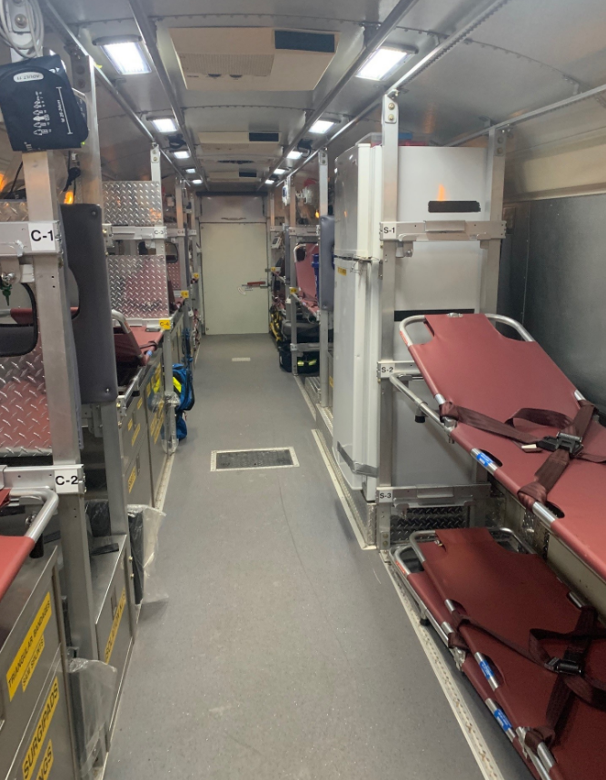
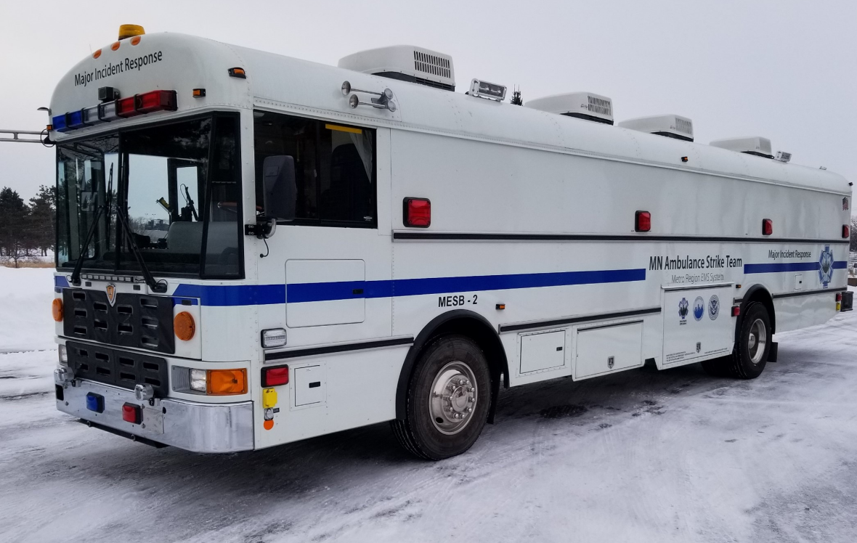
Major Incident Response ( MIR) Bus
Notes:
Capabilities
How to get it? Deployment timeframes
Planned and unplanned
Location – Mhealth in St. Paul

Slide 7
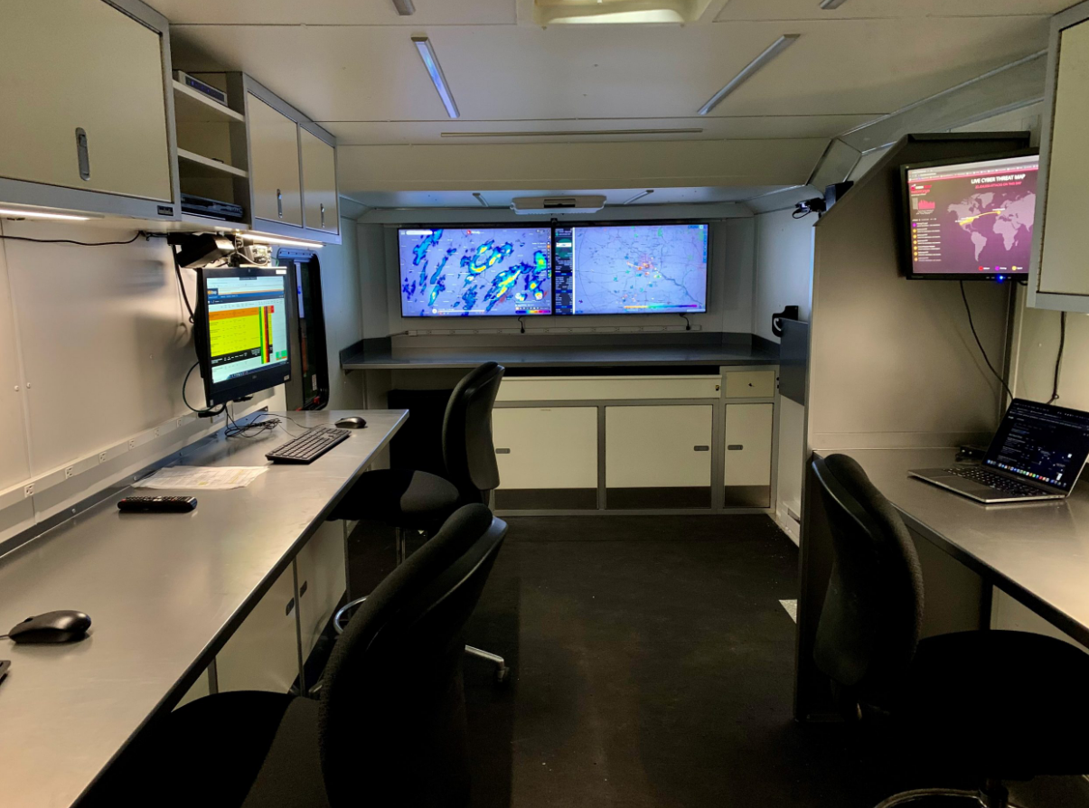
EMS Command/Operations Trailer
Notes:
Capabilities
How to get it? Deployment timeframes
Planned and unplanned
Located at MESB

Slide 8
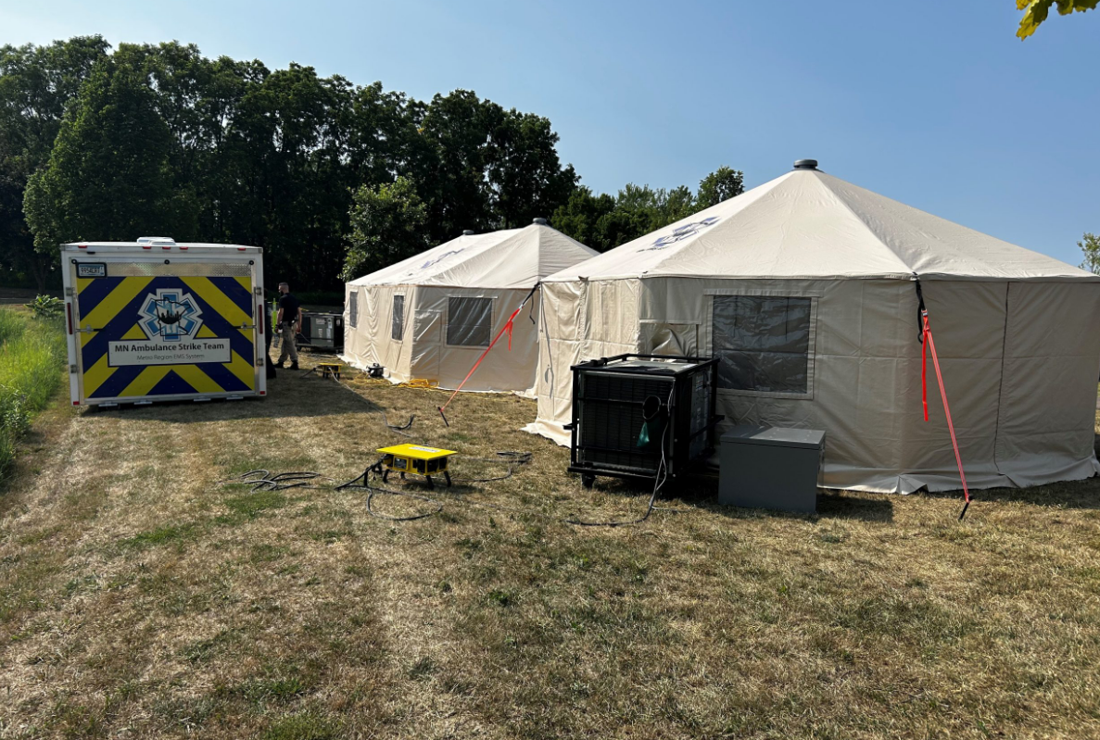
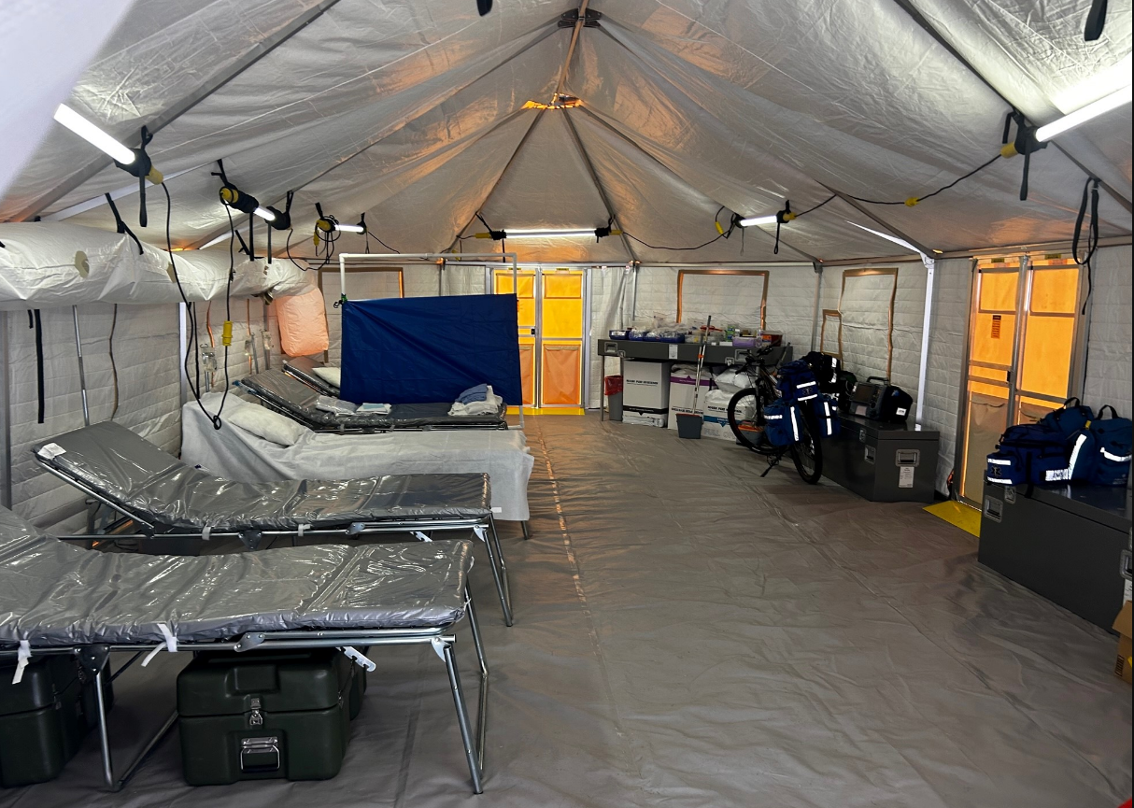
Western Shelters w/Heating and Cooling
Notes:
Capabilities
How to get it? Deployment timeframes
Planned and unplanned
Location MESB

Slide 9
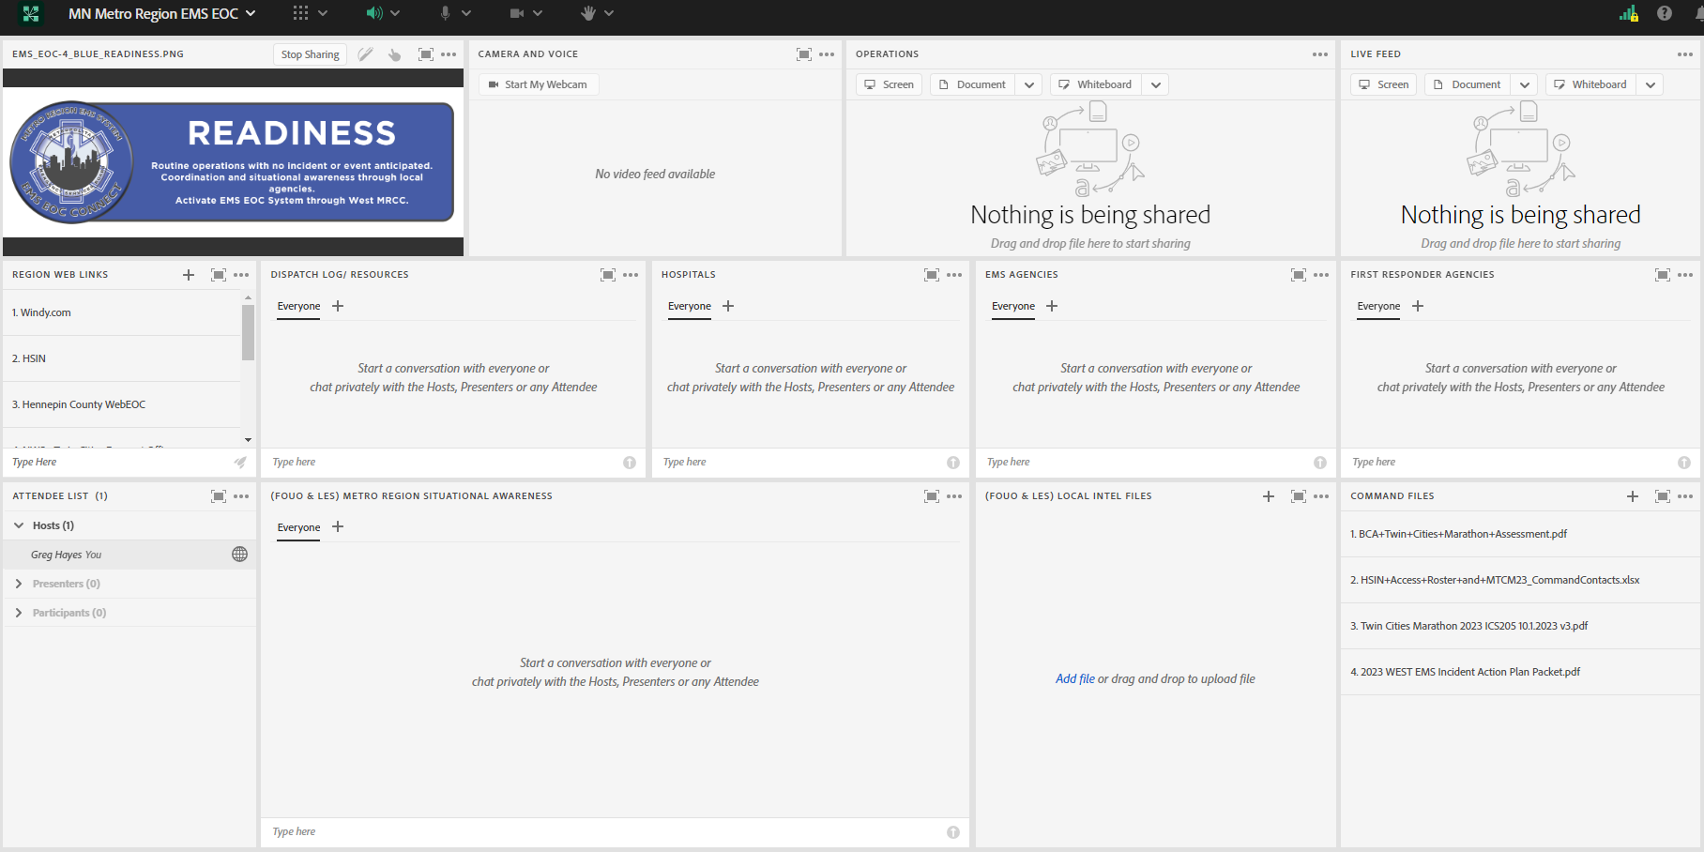
Virtual EOC
Notes:
Secure Adobe connect platform.
Allows Regional partners to log in and provide information related to an event or incident.
Sharing of intel among EMS agencies.
Facilitate conversation through chat or video conference.
MNTRAC will send out page with virtual EOC details – check with home agency to ensure that receive MNTRAC system advisory's to phone or email

Slide 10
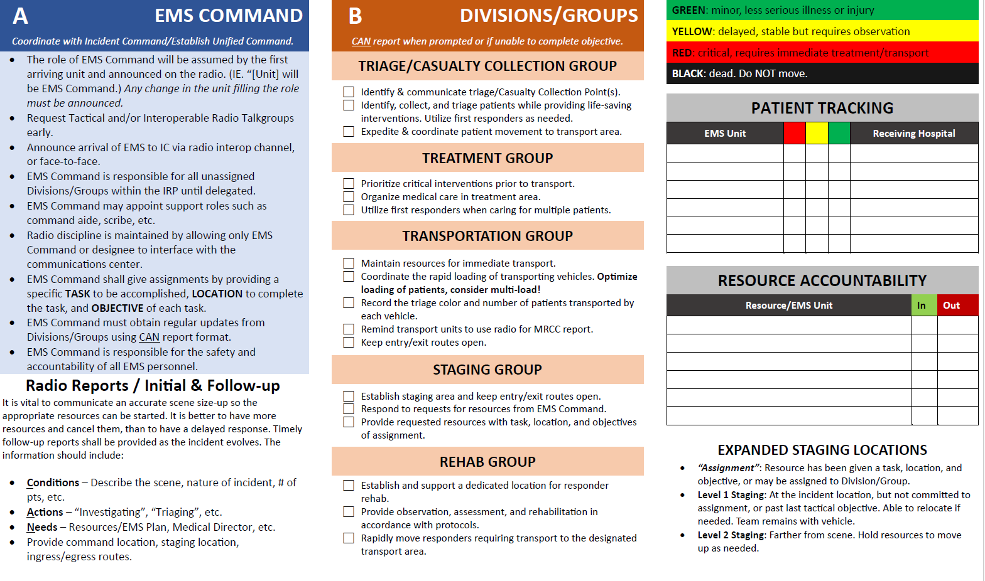
Metro Region EMS Incident response plan
Notes:
Revisions have lead us to this.
Ensure class has trifolds to review in real time

Slide 11
Command System Considerations

Slide 12
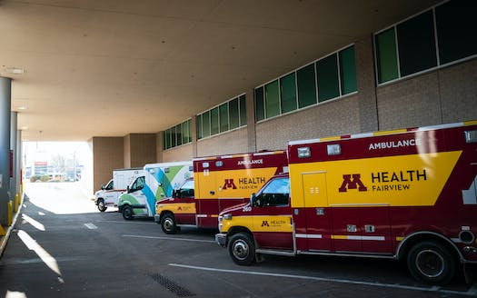
Overall incident stabilization goal
To plan an appropriate and effective response for planned events and major incidents.
To provide expeditious transport to definitive care after a traumatic event.
Notes:
Work together with other agencies to take care of the problem and take care of the people. We need each other to work efficiently and effectively.

Slide 13
Response and scene Control
Someone needs to take control of scene
Organize
Divide into manageable pieces
IC
PIO
Finance
Logistics
Operations
Liaison
Planning
Example ICS Command System
Notes:
If a large or growing incident with moving parts, the commander needs to prioritize setting up Groups/Divisions as soon as possible. By sub-dividing down into more manageable pieces, Command can focus at the Strategic level. (Span of Control)
Remember…not every incident rises to full scale NIMS ICS set up (i.e. Type 1-3). Initial response with command and control focuses on Command and initial operations. An Incident Management Team may stand-up other parts of the system during multi-operational period incidents.
Many stay in the Type IV/V range, but a scaled back version if ICS organization is needed

Slide 14
Tactical Priorities
Hazard Control
Life Safety
Triage
Extrication
Treatment
Transportation
Notes:
Some of these could be happening simultaneously. The thought is that if we take care of the problem (fire, bad guy, etc.) then we can start taking care of the people.

Slide 15
Resource management
3 Deep Model
Actively Working
Level I and II Staging
Ready to Work
M3
M6
M1
M2
M8
M4
M9
M7
Notes:
Applicable to all-hazards. Better to have and not need than to need and not have. Frontload incidents!
Being best prepared for a growing incident.
Actively engaged with patients or assignment – Those prepared to step-up and receive assignment – Those in reserves to back fill as incident grows.
Patient hand-off should occur in the warm zone, with ready reserve resources.

Slide 16
Communications
Radio Discipline
Face to Face
Standard Unit ID
Interoperability Talkgroups
Notes:
In nearly every after action review of a major incident, communications is identified as contributing to a failure or an opportunity for improvement.
Radio discipline – Important communication only – Command drives the radio communication, gives assignments, requests updates/progress reports. Utilize CAN format for IRR/progress reports.
Face to face - Will most often happen at task and tactical level or conversational communication
Standard unit ID – agency, resource type, unit #
Establish Interoperability Early – Consider STAC for large/growing incidents – limitations of ME tac for non-metro agencies – other channels

Slide 17
Communications
Standard Unit ID (Agency, Resource Type, Unit ID)
Ambulance Company, Ambulance, A1
Ambulance Company, Supervisor, S1
Radio Talkgroups/Channels
Internal Tac
METAC (Metro Region) / STAC (Statewide)
Other Interop
Notes:
Radio discipline – Important communication only – Command drives the radio communication, gives assignments, requests updates/progress reports. Utilize CAN format for IRR/progress reports.
Face to face - Will most often happen at task and tactical level or conversational communication
Standard unit ID – agency, resource type, unit #
Establish Interoperability Early – Consider STAC for large/growing incidents – limitations of ME tac for non-metro agencies – other channels

Slide 18
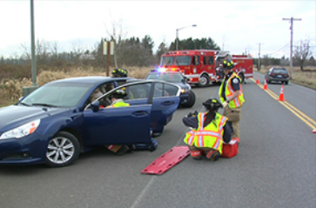
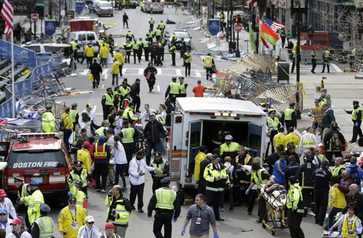
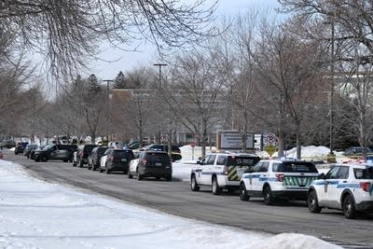
Position management and resource placement
Scene protection
IC out of hazard zone
Ambulance ingress and egress
Notes:
IC must ensure the safety, accountability, and welfare of responders and patients. We need to make sure that the scene is as safe as possible.
In an incident where there is a threat to responders, EMS command will determine corridors of safety with police. In this situation it may be necessary to rapidly cycle ambulances from staging to the loading point, load, and go. EMS command will work with the staging and transport group supervisors in this case.
This may mean keeping others out by establishing a perimeter with people, objects, or vehicles.
IC must manage apparatus placement in a manner that will protect the scene and/or to maintain a lane for ambulances to safely access and transport.
IC should set up outside of the hazard zone to ensure safe working area.

Slide 19
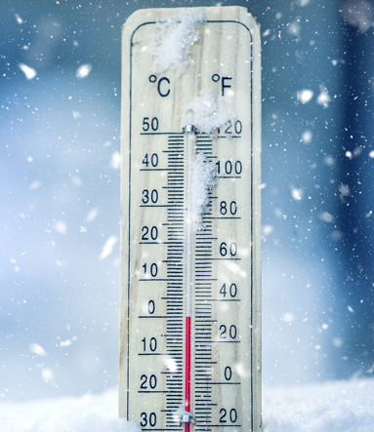
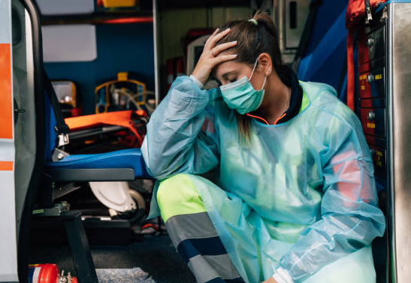
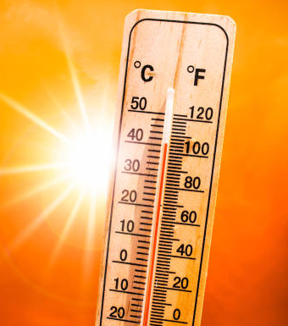
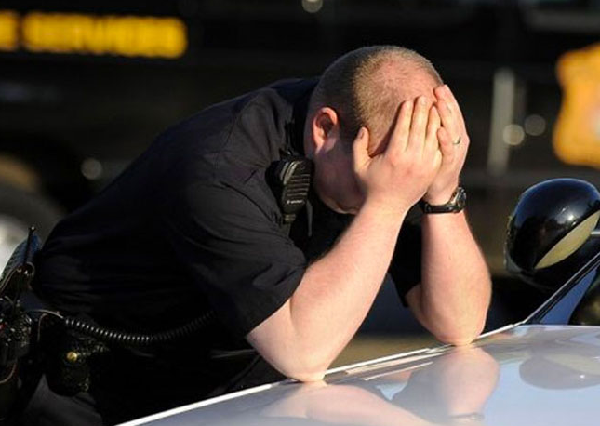
Work rest cycles
PPE needed
Time of Day
Season
Resources
Incident Duration
Notes:
How big is the incident? Think about duration/operational periods.
What is the weather like?
How physically demanding is the work?
IC must ensure responders are wearing proper PPE.

Slide 20
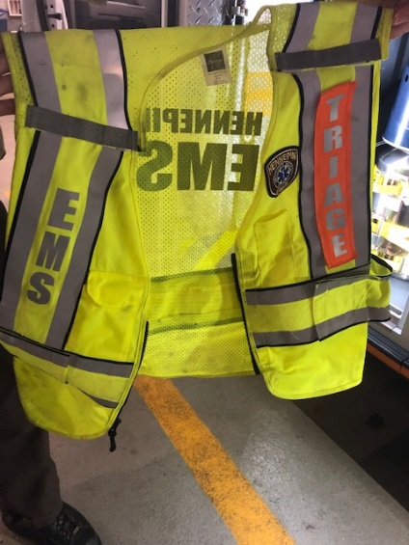
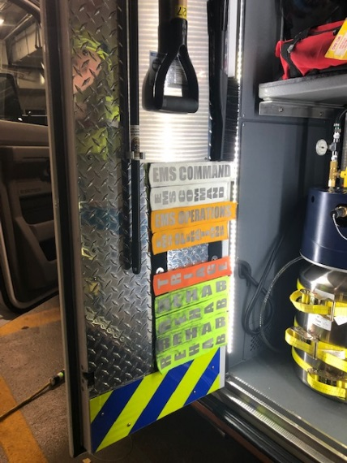
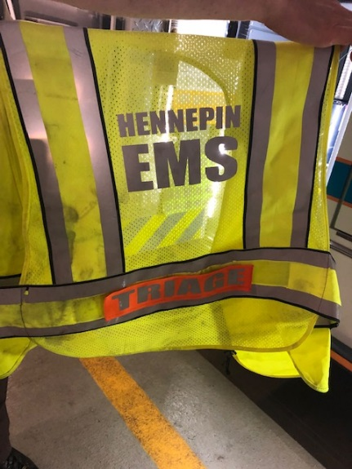
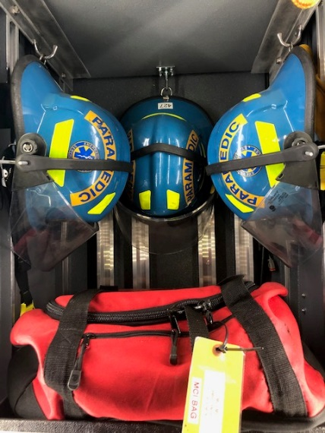
EMS Scene Expectations
Hi-Viz Safety Vests
Helmets
Safe Area Operations
Notes:
It is the expectation that units operating on scenes or roadways will wear hi-viz vests.
Appropriate Velcro tags shall be applied.
Helmets shall be worn when those around you are also wearing helmets… take a hint from those who know better.
Ensure you and your equipment are staged and/or operating in a safe area.

Slide 21
Critical factors of the incident
Notes:
Critical factors offer a standard list that the Commander must consider in the evaluation of an incident. Critical Factors are determined through deliberate and focused size‐up with intent of evaluating the incident to determine how and to what extent the tactical objectives will be met for any particular incident.

Slide 22
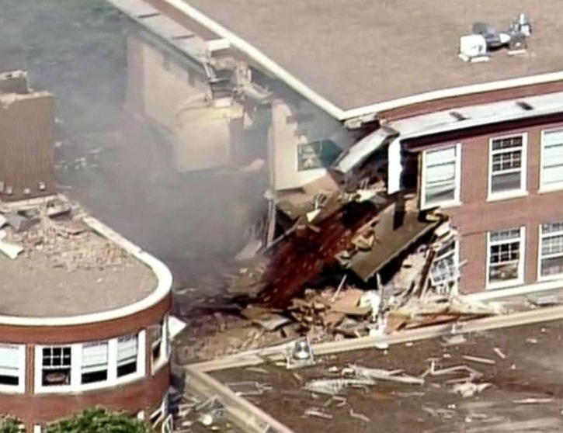
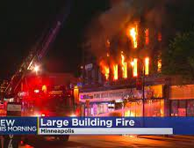
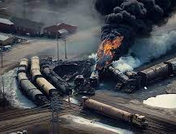
Event Trigger
Vehicle Accident
HAZMAT/WMD
Environmental
Machinery
Fire
Collapse
Explosion
Acts of violence
Notes:
Any multi-resource response needs a command system established to manage it.

Slide 23
Life safety
As quickly as possible
Remove patients from immediate danger
Triage all patients involved
Obtain accurate patient count and level of care required
Determine appropriate level of resources to extricate, triage, treat, and transport
Extricate all patients to a triage area/casualty collection point
Deliver appropriate level of treatment to all patients involved – Address Life Threats
Continue care and transport all patients to appropriate definitive care
Notes:
Critical Factors – Life Safety

Slide 24
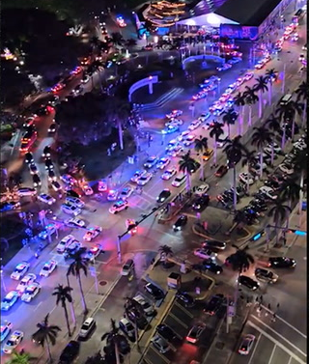
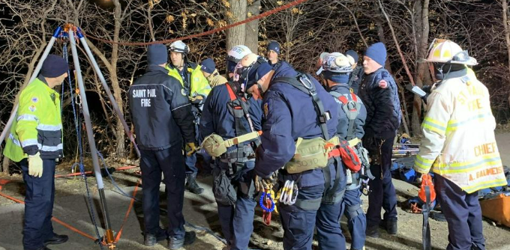
Patient environment
Any patients exposed to IDLH environment/immediate danger?
Any patients/rescuers require decontamination?
What is the scope/size of impact area?
Are there any patients trapped (vehicles, buildings, etc.)?
Are there any patients located within difficult topography?
How much resource/equipment will be required to extricate patients from current environment to treatment/transport area?
Notes:
Critical Factors – Patient Environment
Alert hospitals of patients that need decon.

Slide 25
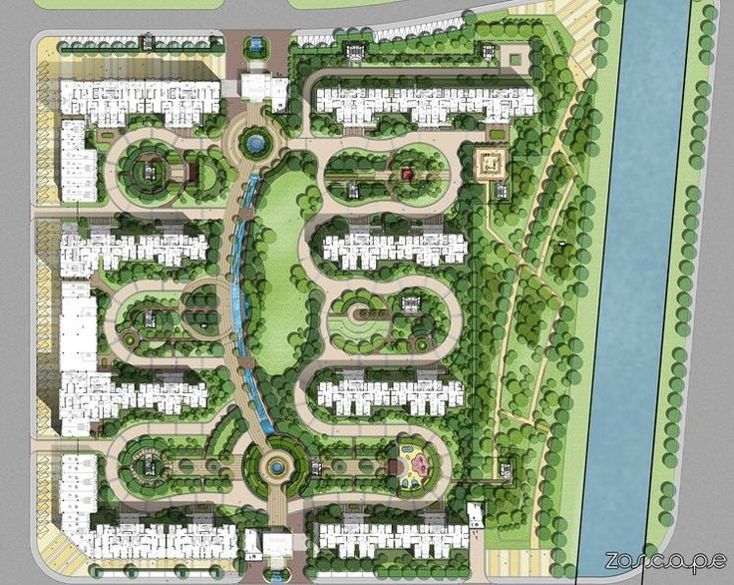
Arrangement
Access for law, fire, and EMS – to and from scene
Protect the incident scene/impact area
Traffic conditions surrounding incident scene
Identifying best locations for:
Level 1 and 2 staging
Unit travel time from staging to work assignment/patient locations
Patient travel times from extrication to triage area/casualty collection point
Patient travel times from triage/CCP to transport area
Patient transport times from scene to hospital
Notes:
Critical Factors – Arrangement
Ease of access.
Patient travel times from triage/CCP to transport area – Establish CCP in easily accessible area for transport.

Slide 26
resources
Staffing/Equipment on scene, responding, or in reserve
Capabilities of responding personnel
Transport capabilities
Extrication/Rescue capabilities
Decon/HAZMAT capabilities
CHEMPACK
Response times
Medical Director/Physician
Law enforcement to manage, maintain, and document
Manage/interact with other agencies as required
Notes:
Critical Factors – Resources
Talk about hazardous material awareness. Index of suspicion high for things that don’t seem right. Don’t forget decon, need for resources such as CHEMPACKs, etc.
CHEMPACKs are containers of nerve agent antidotes placed in secure locations in local jurisdictions around the country to allow rapid response to a chemical incident. Be aware of and understand how to activate Chempacks. A call to MRCC by radio or phone will activate system. Be ready to coordinate drop-off location if requesting to scene.
1,960 containers strategically placed in more than 1,340 locations in the United States…

Slide 27
actions
Effect current action is having?
What needs to be done?
Stage of operation (extrication, triage, treatment, transport)?
Effective incident organization in place?
Enough resources and qualified personnel on scene or responding?
Hospital notifications made?
Crews operating safely?
Notes:
Critical Factors – Actions
Incident Organization – would the incident be better served with divisions/groups?

Slide 28
Special considerations
Time of day
Day of week
Season
Special Hazards
Weather
Notes:
Critical Factors – Special Considerations
Time of day – traffic flow, occupancy, etc.
Day of week
Season
Special hazards – holiday gatherings and other special events
Weather – wind, rain, snow, heat, cold, humidity, visibility, etc.

Slide 29
Putting the irp into action

Slide 30
Notes:
Ensure class has trifolds to review in real time

Slide 31
Deployment
Daily operations vary for EMS, Fire, and Law
Local EMS dispatch should be based on overall EMS resource levels
Transport ambulances – private, fire based, helicopters
Local FD/PD first response
Responder medical capabilities
Notes:
Starts with deployment. Which is now universally accepted or preplanned in the metro area under the new IRP.
Some cities/services can handle large events internally vs areas that need auto-aid, etc. Individual areas should be aware of capabilities and initiating Plans early to frontload incidents and have resources available.
Notifications are a big part of the EMS Plans, sharing awareness across the EMS systems and hospitals for overall system impact.

Slide 32
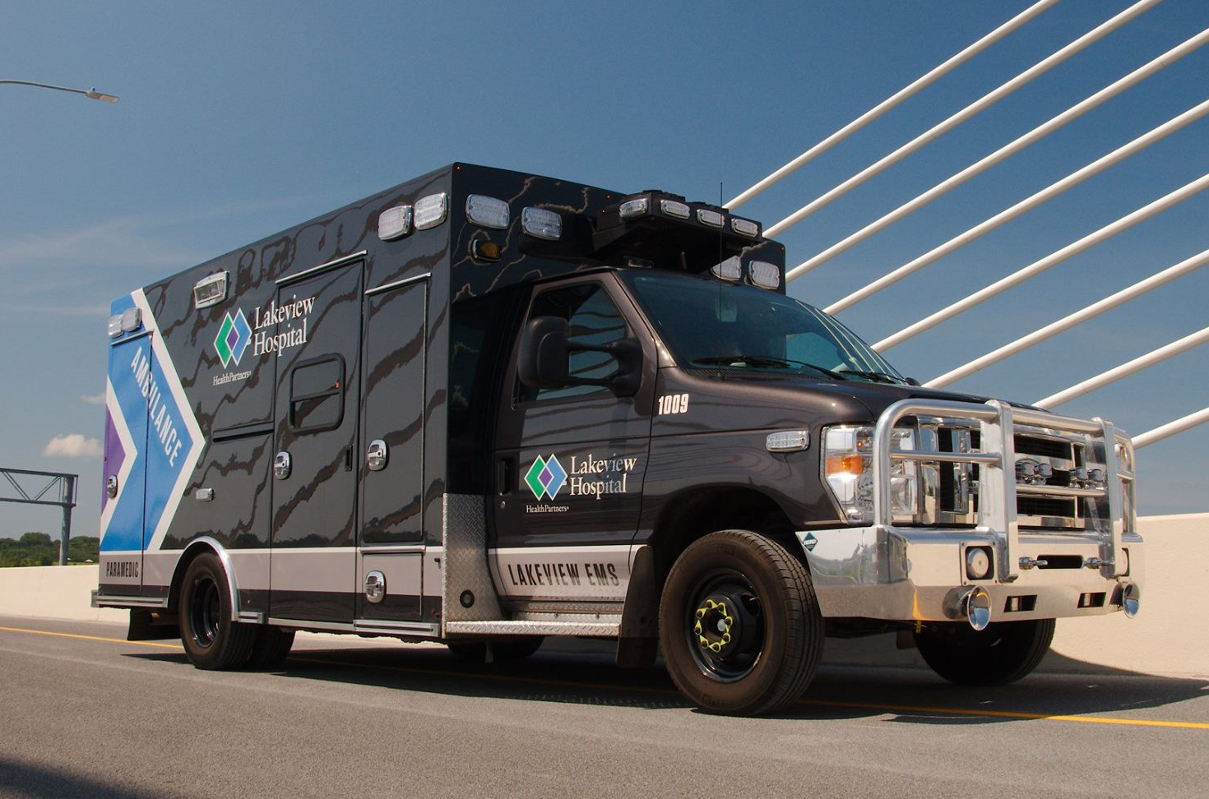
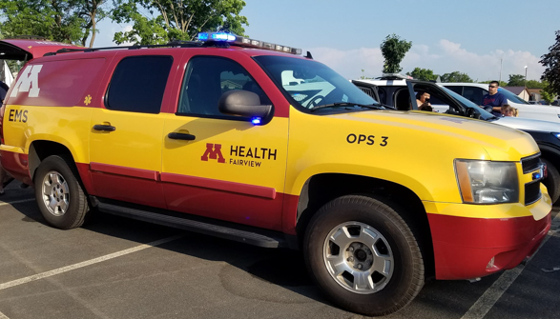
First arriver - EMS Command
Notes:
It starts with the first to arrive. Importance of command – why it is important that we did? Learn? And implement?
EMS command is not overall incident commander – part of UC team
EMS stand alone vs. Fire based – still give as much information as available – working to create “UC” – nothing precludes
EMS Command communicates with Dispatch to provide updates and request resources. All other personnel operating on the incident go through Command.

Slide 33
Initial Radio Report (IRR) – Scene Size-up
PTT = Push to Talk, not Push to Think
When keying up, why?
Also include:
Designated staging location and ingress/egress routes
Important information concerning access
Name and assuming command
Notes:
One of the most important messages we transmit throughout the entire incident. The first 5 minutes can dictate the next 5 hours. As mentioned above…
(What do you see?)
(What are you doing?)
(What do you need?)
Audio clip of IRR??????
Add metro department photos
When keying up, why are we keying up? Lead with the reason. “Burnsville Medic 1 arriving with an initial radio report.” “Follow-up report”, etc.

Slide 34
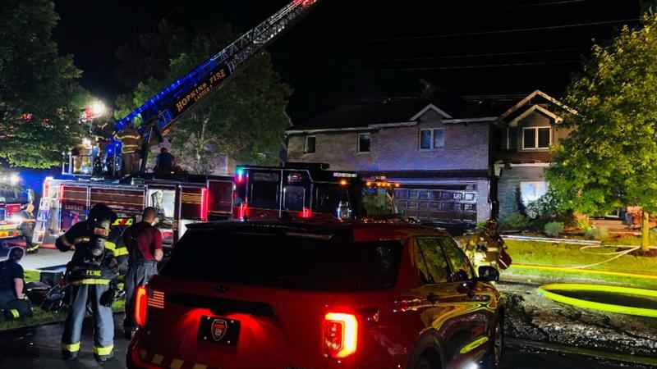
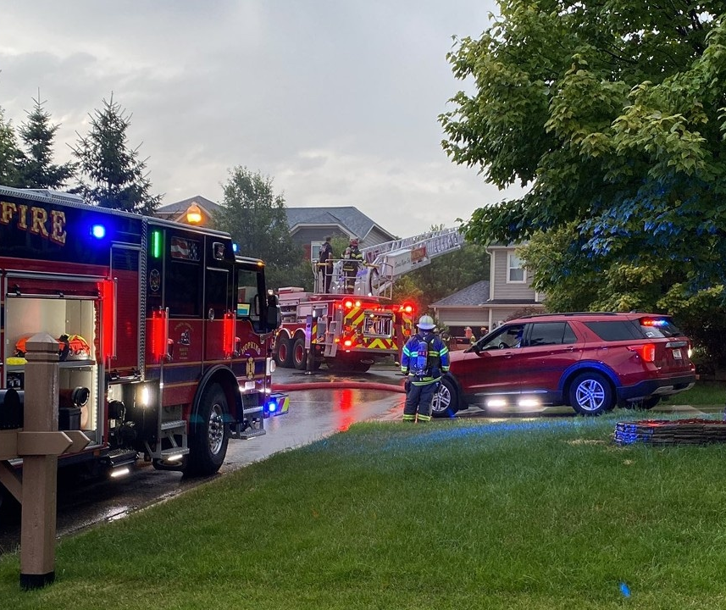
First arriver - EMS Command
Interop w/Outside Agencies
Announce Arrival on Interop
“Command, Hennepin EMS Ambulance 4## Arriving”
Command will give assignment
Rehab
Stage with equipment at X location
Report to Command Post
If no assignment, stay with vehicle
No face-to-face

Slide 35
Initial Radio Report Practice
Scenario 1
Scenario 2
Scenario 3
Scenario 4
Notes:
IRR Practice Scenarios

Slide 36
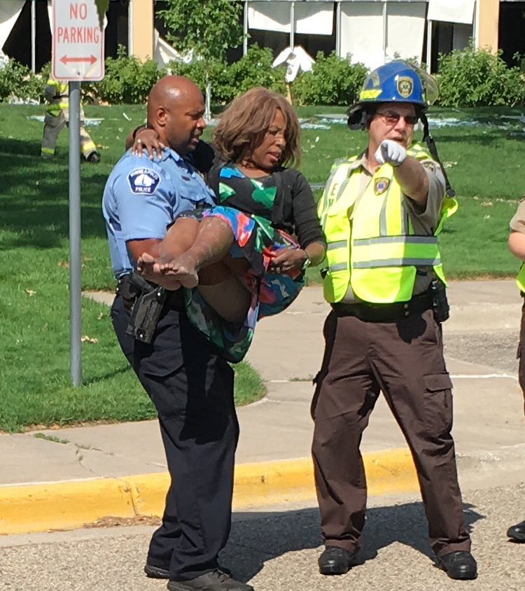
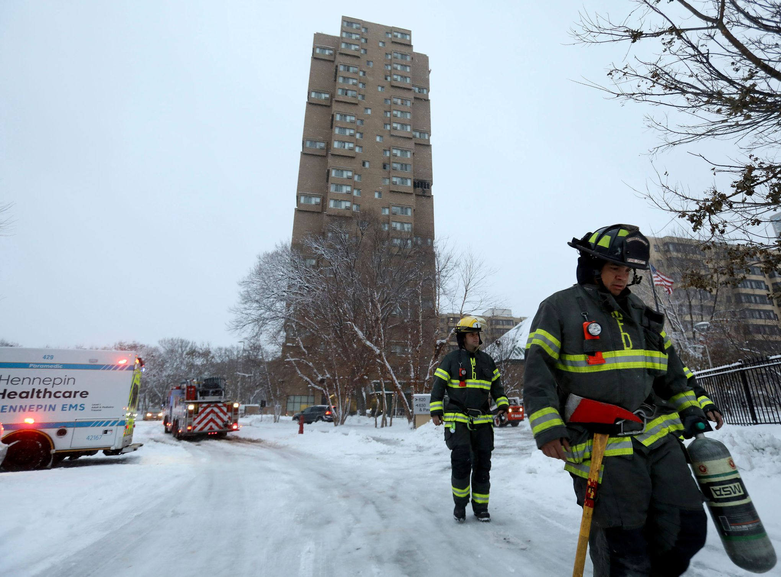
Command vs. Patient Care Considerations
# of patients
Treatment priorities
Life threatening injuries
Accountability of responding resources
Available equipment
Task saturation
Difficult Scenario
Notes:
First arriver has to decide whether they will do more good taking action or if they are better served setting the stage for the numerous resources that are on the way.
Mobile IC – multitasking can be challenging. Trying to identify, treat, collect patients while simultaneously listening for radio traffic and assigning units is A LOT
It may take time for supervisor/chief to arrive
Stationary IC – controlled environment, can use tools around (i.e. computer, notebooks, multiple radios, etc.)
Emphasis on doing a very thorough assessment of the scene – make contact with witness, with PD…

Slide 37
TRANSFER OF COMMAND
Shift from Tactical First Arriving Unit/IC #1 to Strategic Chief Officer IC #2
Command is stationary, removed from patient care and other task level work
Radio Transfer with CAN Report & Accountability
Contact the Initial IC/IC #1
Assume Strategic Command
Assume Mobile Command
Remain Staged
“I’ll take EMS Command from here.”
“I’ll take EMS Command and join you.”
“You can stay in Command. We’re staged if you need us.”
Notes:
Transfer Command to IMPROVE. Does First Arriver keep or pass? Never taken… a transfer MUST occur.
Contact the initial EMS Command/IC #1 – Verify locations and objectives, obtain CAN report.
Assume Strategic Command – “I’ll take EMS Command from here.” Contact dispatch, assume EMS Command, confirm or change incident action plan, confirm or adjust resources. Manage the incident.
Assume Mobile Command – “I’ll take EMS Command and join you.” Contact dispatch, assume EMS Command, confirm or change incident action plan, confirm or adjust resources. Manage the incident.
Remain Staged – “You can stay in EMS Command. We’re staged if you need us.” Monitor the incident and remain ready to carry out task, location, and objectives from EMS Command, or assume EMS Command should situation change.

Slide 38
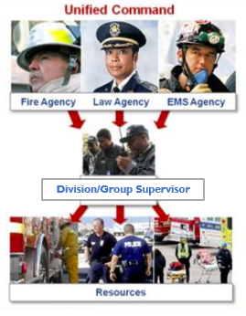
Unified Command
Management system that effectively connects
Law Enforcement
Fire Department
EMS
Hospitals
Tow Trucks
Buses
Municipalities – sand, busses, clean-up, barricades, etc.
Notes:
Link with any FD/PD command that is on scene to create unified command.

Slide 39
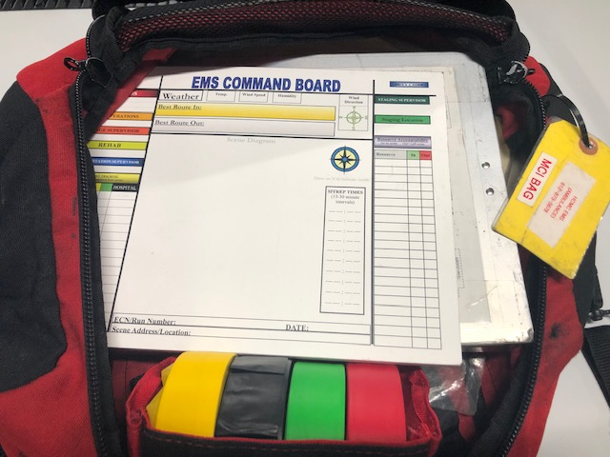
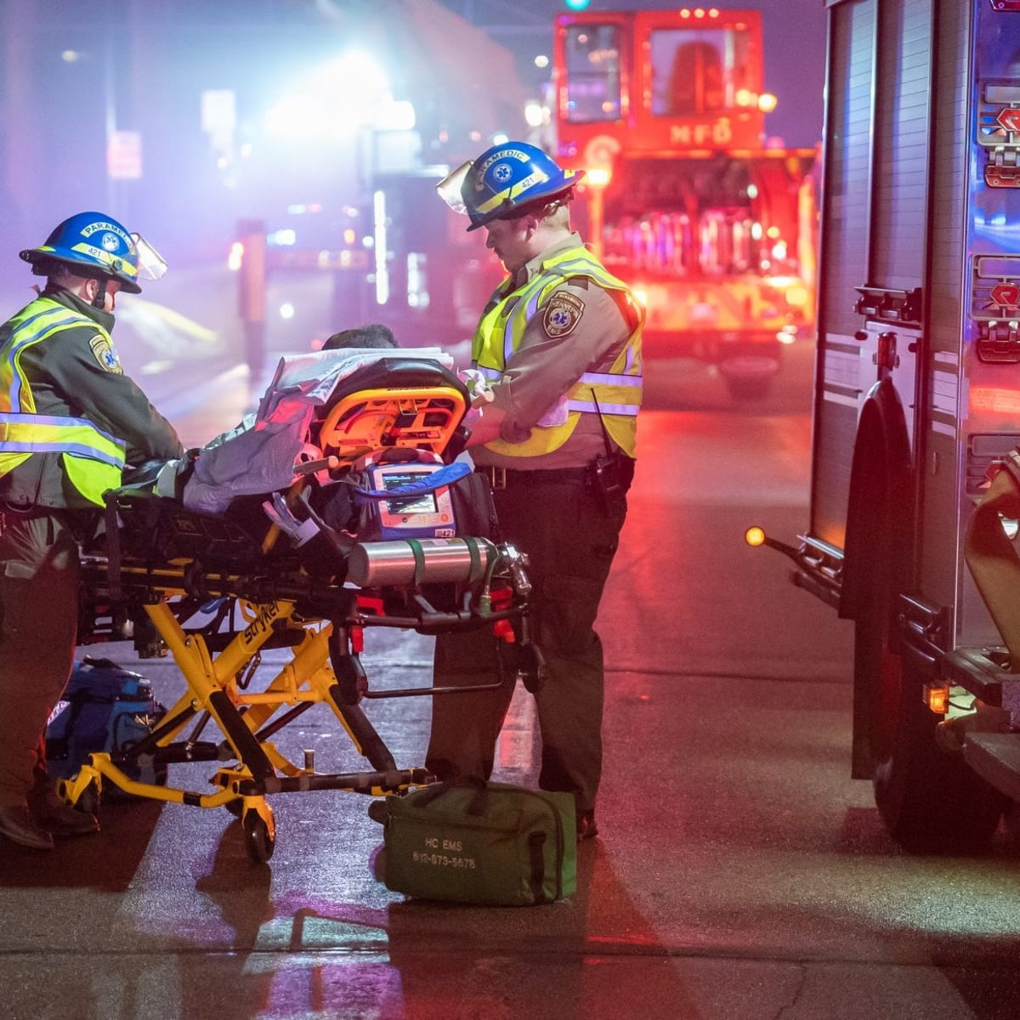
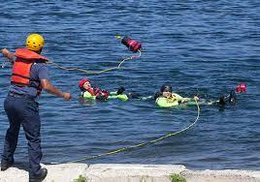
Equipment considerations
Stretcher/Equipment
Weather Considerations
Cyanokit
Blood Products
Throw Rope Bag
MCI Bag
Triage Tape
Bleed Supplies
Command Board
Notes:
Load your stretcher with appropriate equipment. Is this near water? Have your PFD and helmet ON! Throw rope bag? Do you know how to use it?
Are you staging out in the elements, or remaining in your truck?
Does the incident require Cyanokits, Atropine drops, or blood products?
MCI Bag – Triage tape, command board/clipboard. Mega Mover & bleed supplies. Supervisor vehicles are same on steroids, more stuff.

Slide 40
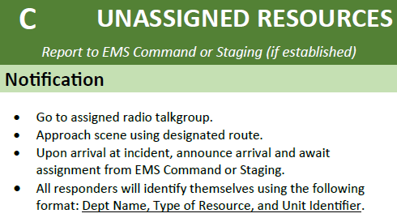
Staging
Arrival on scene and awaiting instructions (Level 1)
Units arriving after command established
Do not pass last tactical objective
Do not impede access to the scene
Arrival close by and predetermined area (Level 2)
Later arriving units
Report to designated area
Report to IC or Staging Supervisor
All units stay inside vehicle until assigned
Notes:
Don’t self assign. Communicate with command/staging supervisor - if approached to assist in other areas.

Slide 41
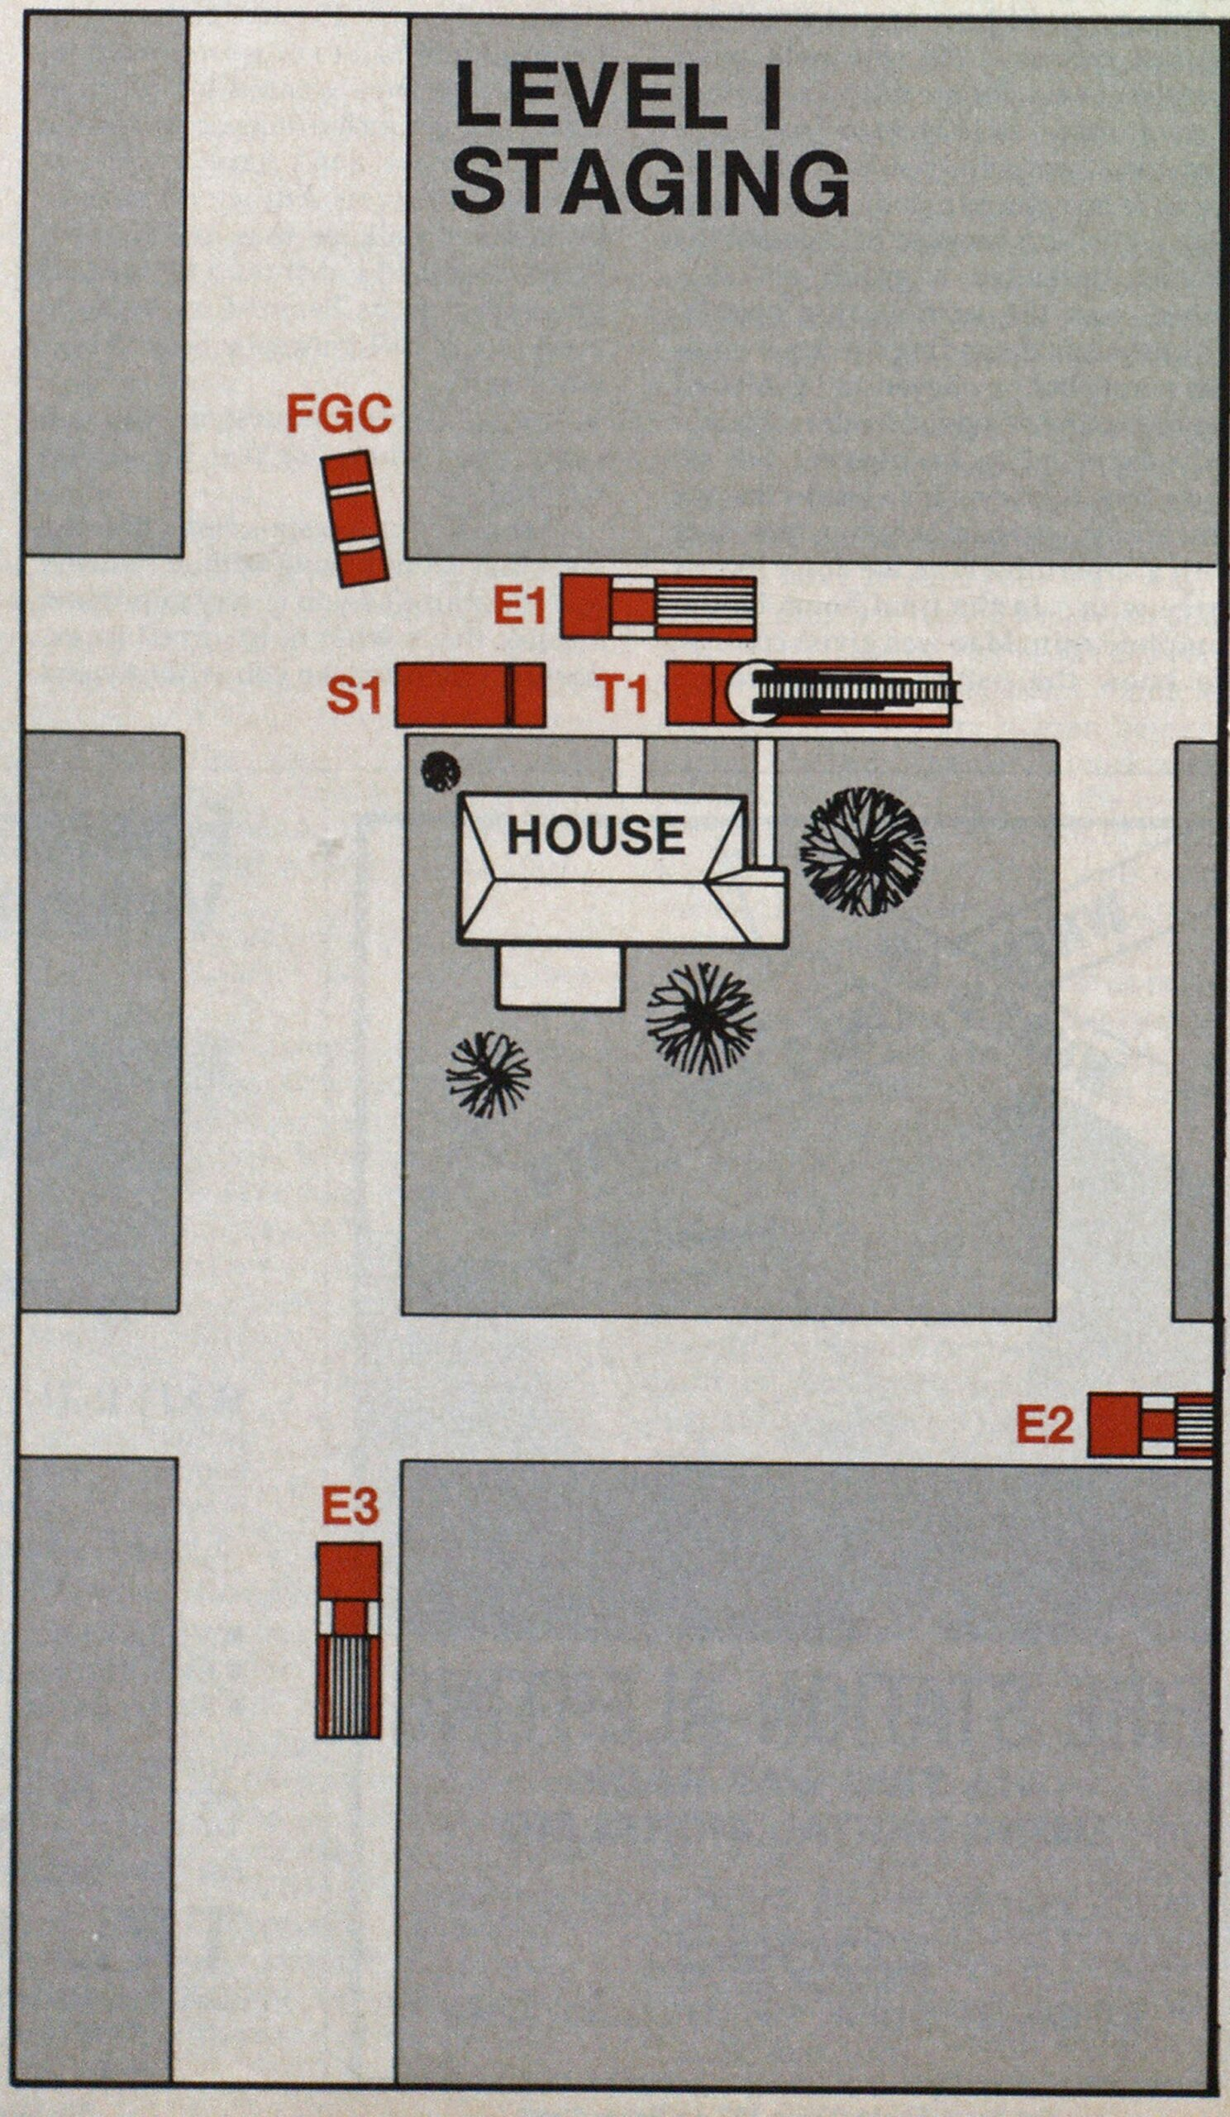
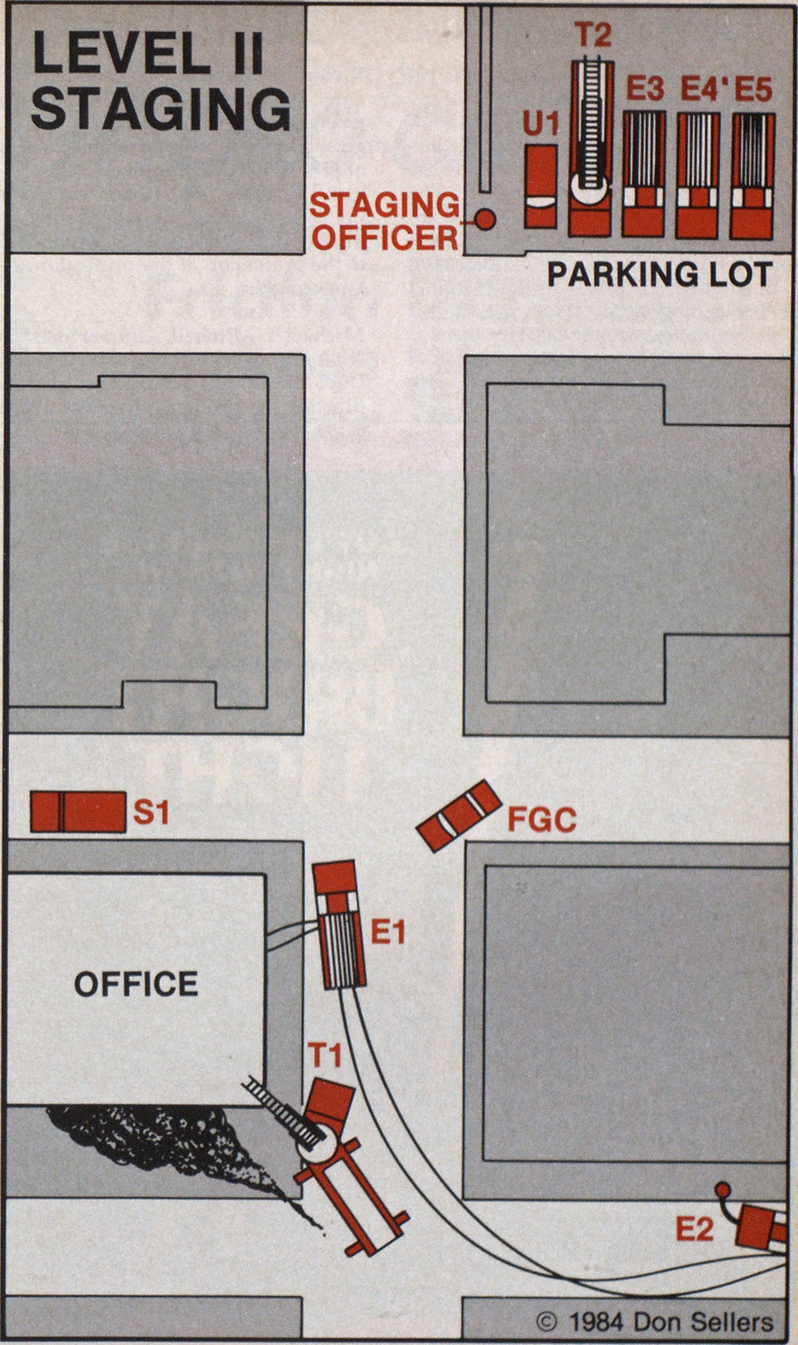

Slide 42
Divisions and groups
Establish early to maintain operational control
Divisions are geographic areas with assigned resources.
Groups are resources assembled to perform a specific function.
Shall have a designated leader/supervisor.
Utilize non-transport assets for supervisor roles.
Resource request still made through command.
Strategic, Tactical, Task
Command
Triage
Treatment
Staging
Transport
Rehab
RTF
RTF
MD
FR
Med 2
Med 3
RTF
Med 5
Med 1
Med 4
MIR Bus
Notes:
On a large-scale incident, this tree will likely look much bigger with many more units working.
Treatment area can utilize first responders to address life threats, keeping transport capable units free.
Explain Transport area should be resources on the move between staging and triage for patient pickup. Or on the move to definitive care.
Tree will look much larger with more resources assigned.

Slide 43
Tactical Responsibilities
Triage/Casualty Collection Group
Treatment Group
Transportation Group
Staging Group
Rehab Group
* All groups will have an assigned supervisor to carry out objectives
Notes:
Remember – each group has a leader. Ensure that each group leader knows who is being assigned to them and their Task, Location, Objective. And be sure that each unit clearly knows who they are reporting to and their Task, Location, Objective

Slide 44
Triage/Casualty Collection Group Objectives
Identify and communicate location
Identify, collect, and triage patients while providing life saving interventions.
Expedite and coordinate patient movement to transport area.
?
Notes:
It is imperative to establish a specific area to collect the injured/ill. Tarps used to sort casualties and the treatment group should only be established when there are inadequate transport resources. That is - keep transporting if you have the resources.
Do not categorize a patient with truncal penetrating injury as yellow, even if they are stable. Trunk injuries are a red, always.
In some cases, large area incidents may have more than one area that are established to collect patients. IC would have to make a decision to either find a way to get all the patients to one area or to start a new division (i.e. Alpha Triage vs. Charlie Triage, Alpha Treatment vs, Charlie Treatment, Alpha Transport vs. Charlie Transport, staging could remain as one group as long as there is access to both sides.

Slide 45
Treatment Group Objectives
Prioritize stabilizing life threats prior to transport
Organize medical care in treatment area
Utilize first responders when caring for multiple patients
Quickly move patients to transport
Notes:
Stabilize life threats immediately upon recognition – move toward transport
Utilize first responders to provide care.
Keep transport units free.

Slide 46
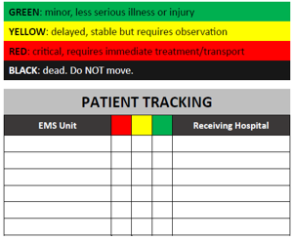
Transportation Group Objectives
Maintain resources for immediate transport
Coordinate the rapid loading of transporting vehicles – consider multi-load
Record the triage color and number of patients transported by each vehicle
Remind transport units to radio MRCC for report
Keep entry/exit routes open
Notes:
Really think about destination. If more than 2 trucks will be transporting, consider multiple hospitals to spread load, especially if criticals.

Slide 47
Transporting patients

Slide 48
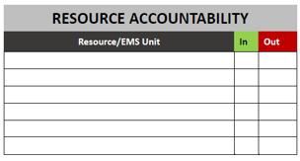
Staging Group Objectives
Report to established staging area
Keep entry and exit routes open
Respond to requests for resources from Command
Provide requested resources with task, locations, and objectives
Keep track of units coming and going

Slide 49
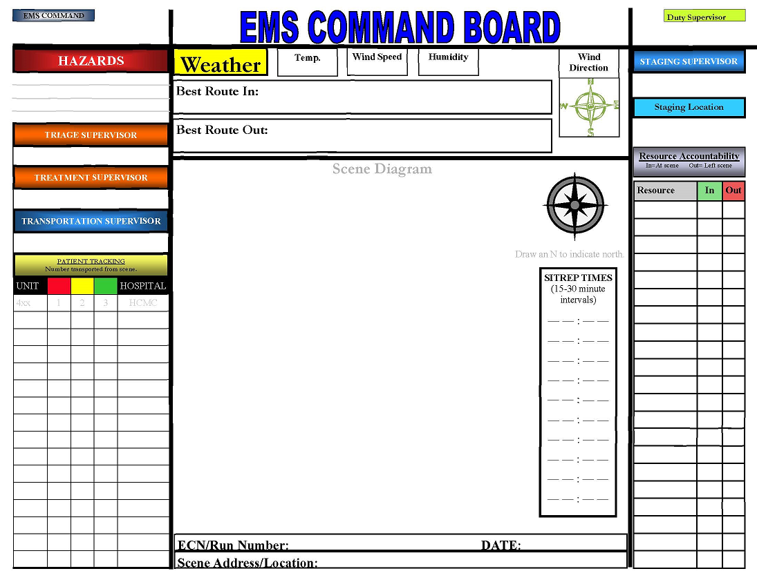
Incident Accountability
IC and/or Group Supervisor(s)
Tactical Worksheets
Incident and resource management
Notes:
Just an example. A tactical worksheet can be as simple as a lined piece of paper. Don’t rely on memory to keep all of the notes, write things down. Enlist a support officer to scribe as needed.

Slide 50
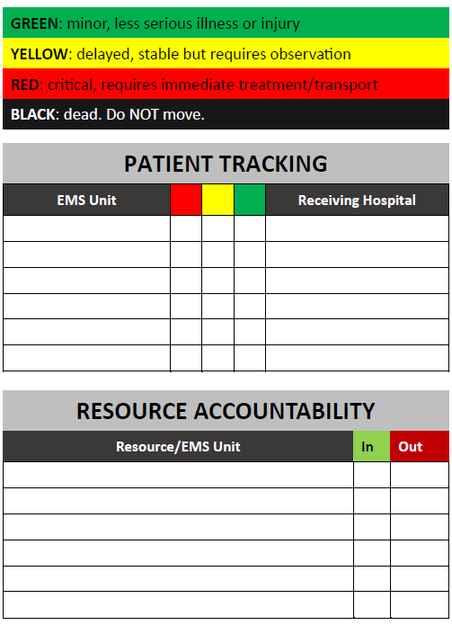
Patient Accountability
Group Supervisors should maintain specific tactical worksheets to track resources, units, and patients.
Should be done in conjunction with East or West MRCC
Notes:
In a chaotic mass injury/mass patient event it can be challenging to get demographic information on patients that we are just trying to save.
Use forms to help track patient information. Description of injury, clothing, gender, etc.
Additionally, there will be many resources filtering in and it is imperative that we keep track of who is where and what they are doing.
MESB will have IC and accountability forms for download on their website.

Slide 51
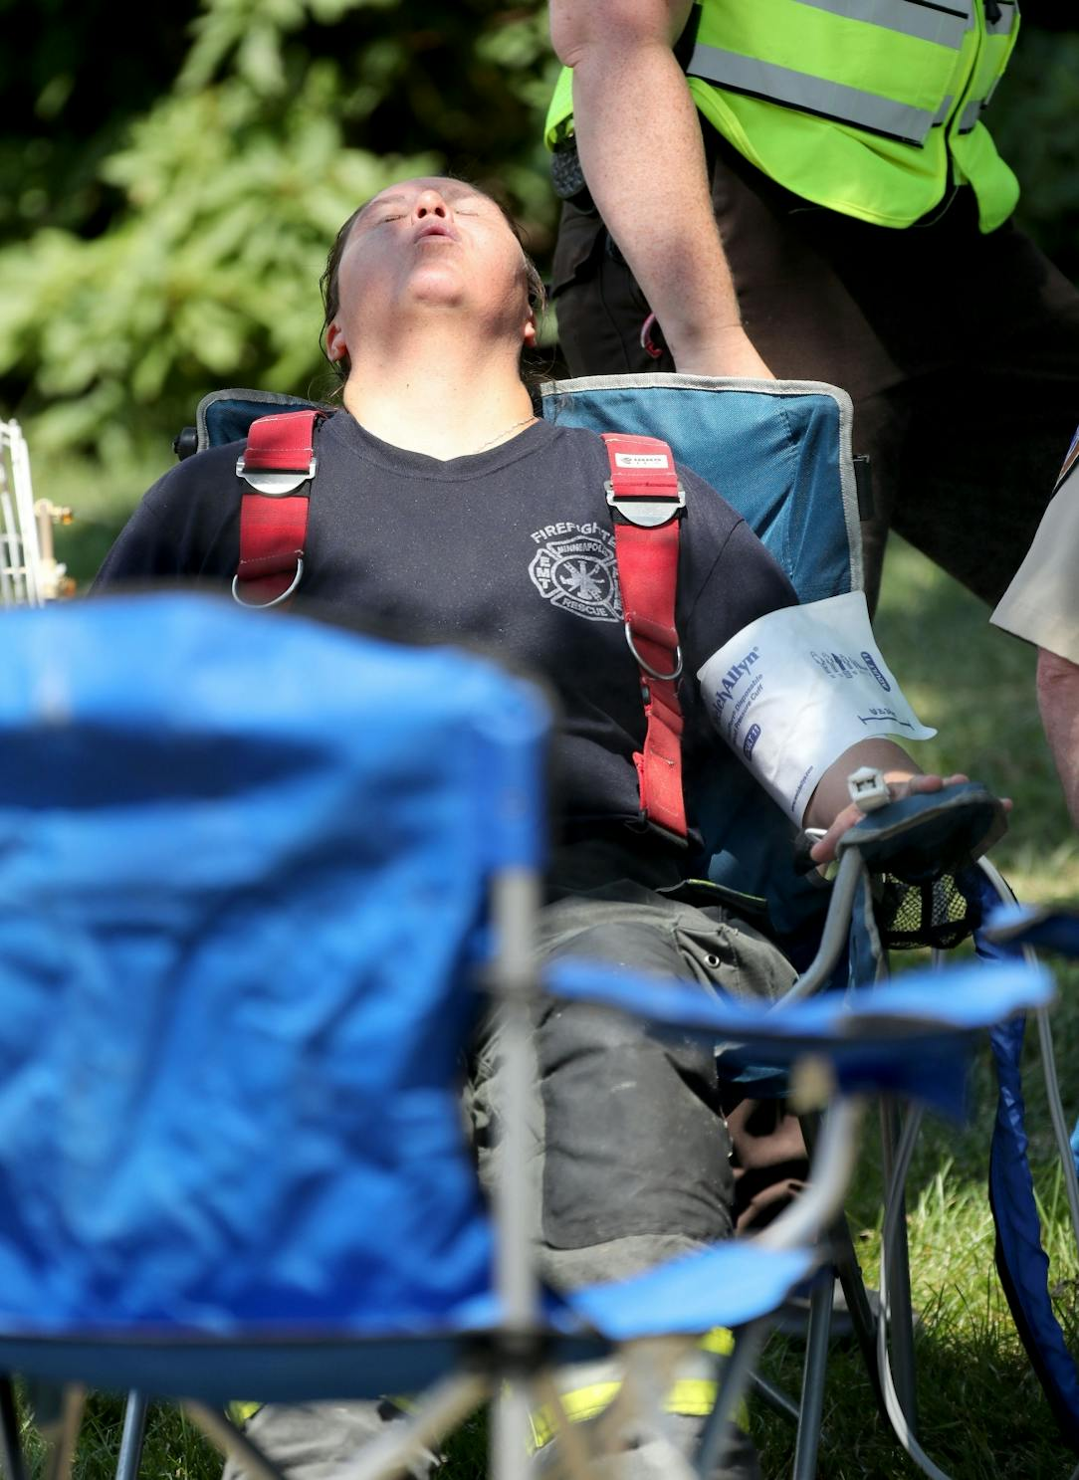
Rehab Group Objectives
Establish and support a dedicated location for responder rehab.
Provide observations, assessment, and rehab in accordance with protocols.
Rapidly move responders requiring transport to the designated transport area.

Slide 52
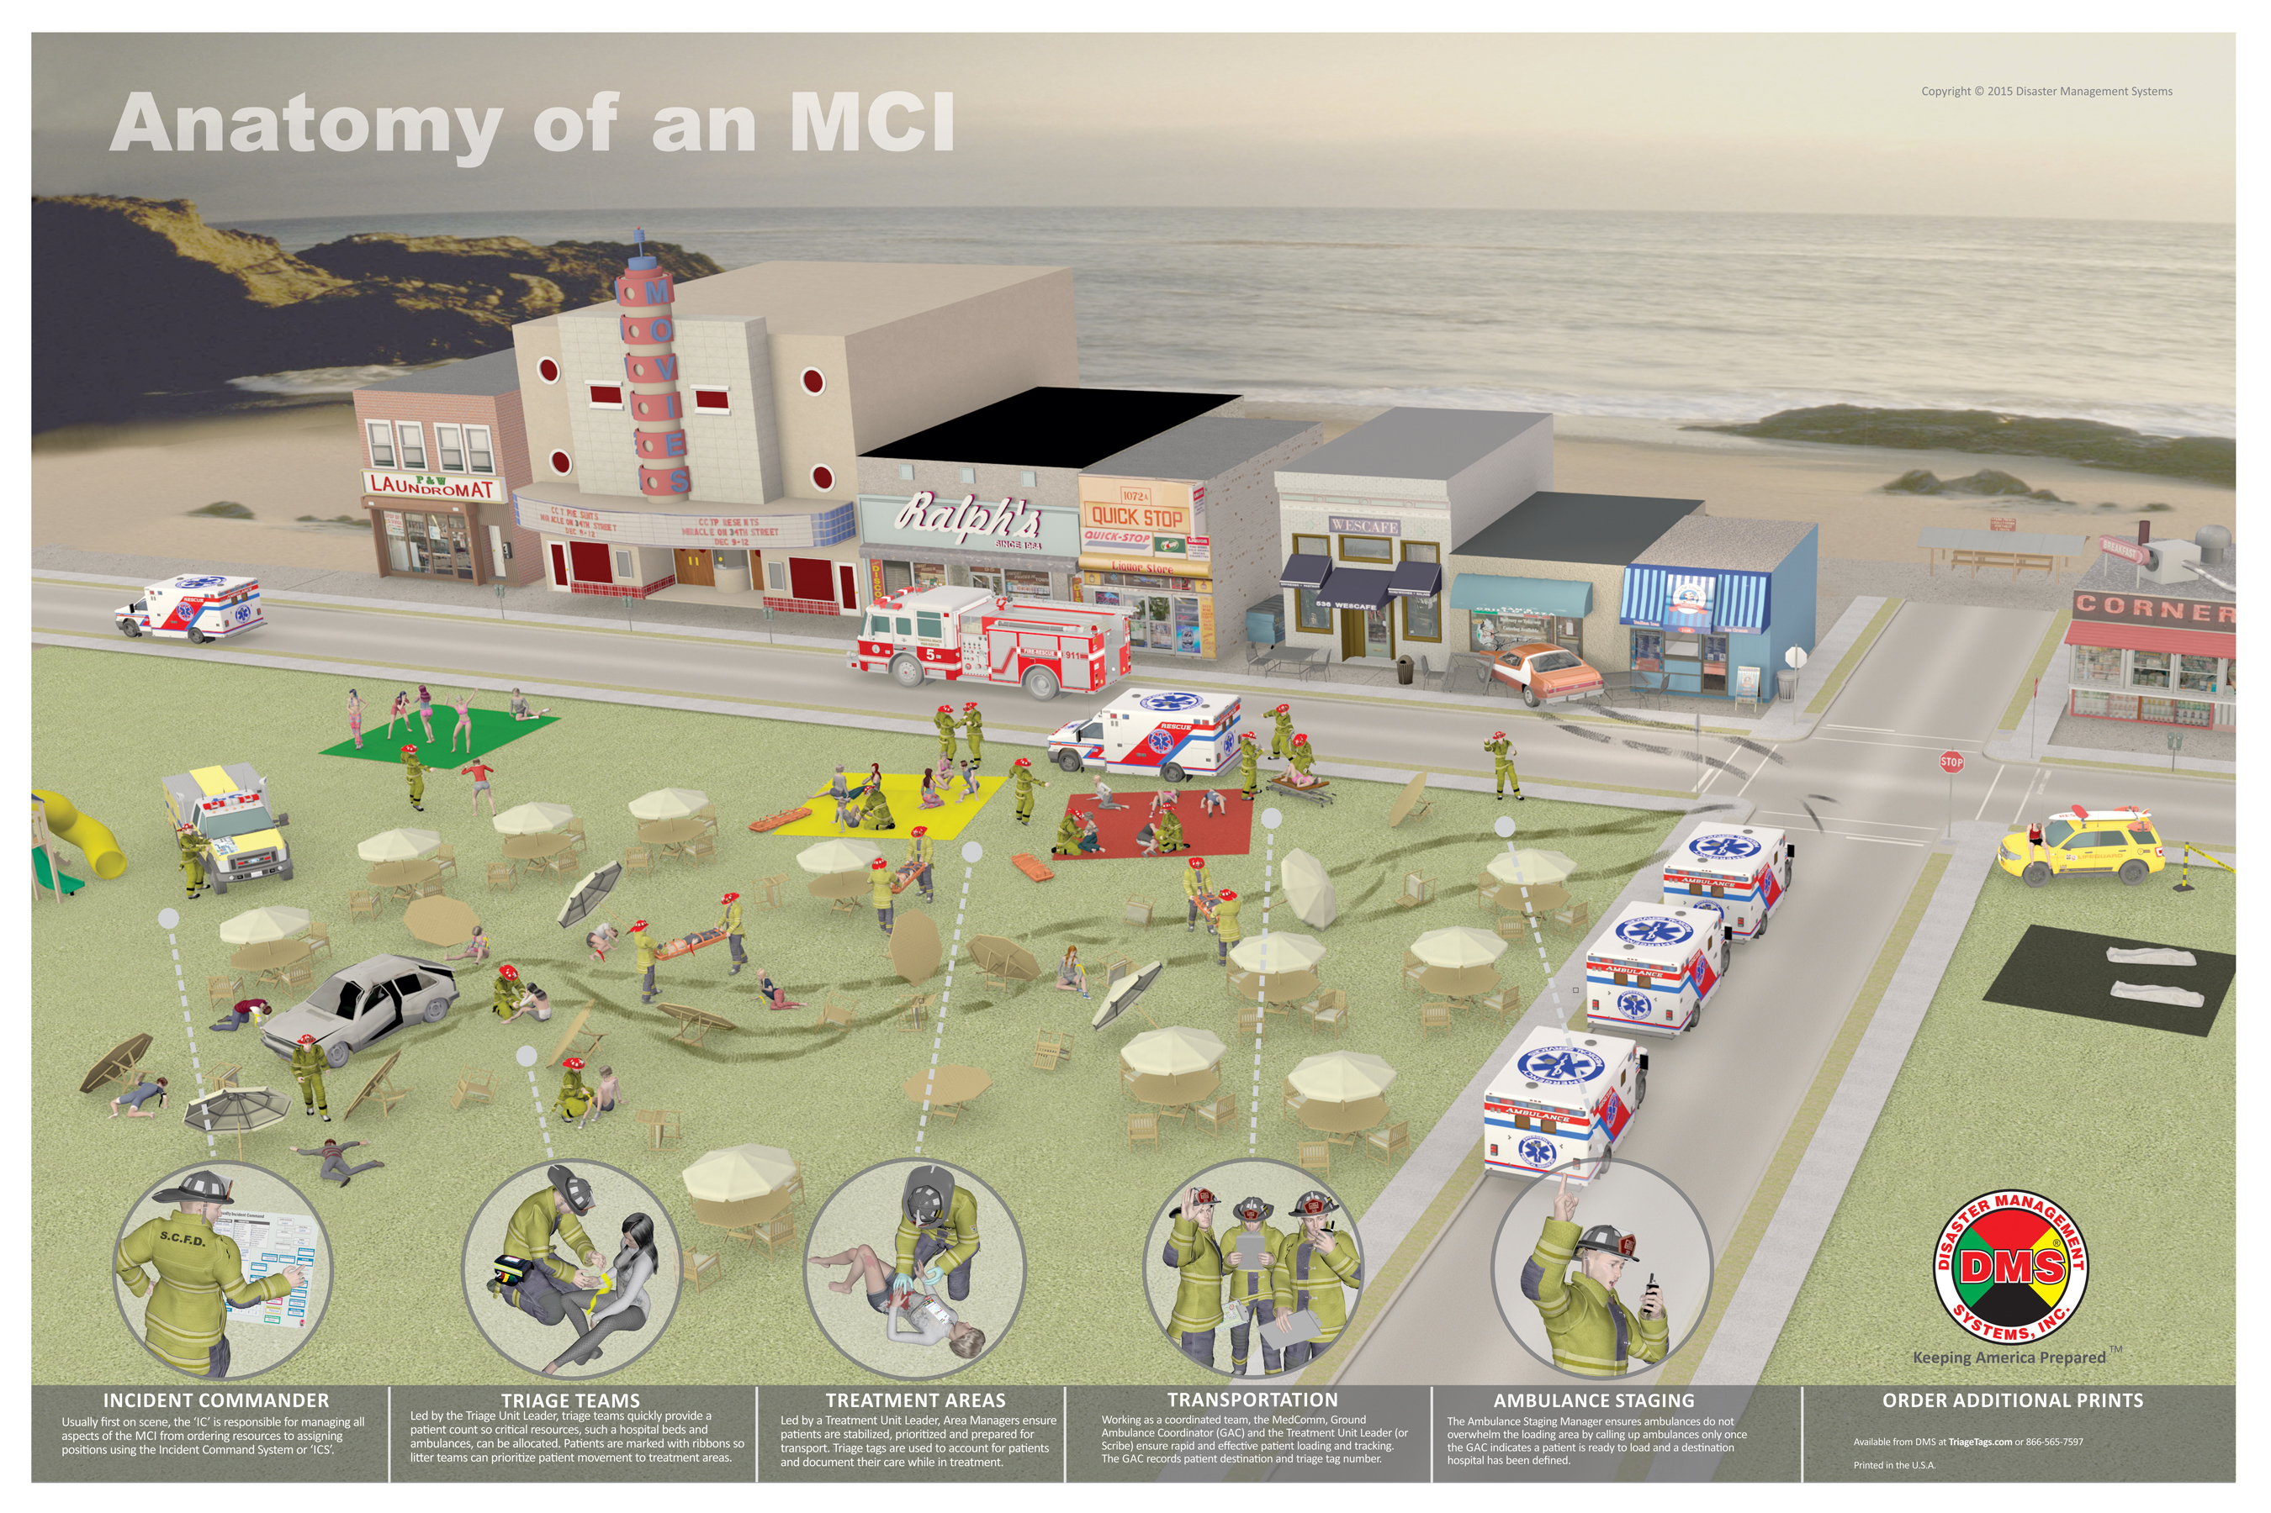

Slide 53
Review, Evaluate, and Revise
Throughout incident consider:
Effect current action is having
Identify and reaffirm things that need to be done
Stage of operation
Forecasted operation
Additional resources
Hospital notifications
Crews operating safely
IC support
Critical Factors
Risk Management
Strategy
Incident Action Plan
Tactical Priorities

Slide 54
Terminating Command
Before terminating or clearing:
Obtain a total patient count and treatment priority numbers
Obtain patient hospital destinations
Confirm hospital arrivals
Verify incident is clear of all patients (primary and secondary) and turn incident over to appropriate authority

Slide 55
Resources
FEMA/National Incident Management System
Blue Card Command
Metro Region EMS System – Disaster Compact & Incident Response Plan

Slide 56
HAZMAT REVIEW
Just a little gas…
Notes:
HAZMAT Review – Awareness

Slide 57
Key POINTS
True gases do not leave residual on skin – e.g. carbon monoxide
Residual in clothing can be a problem – e.g. ammonia
‘Dry decon’ – clothing removal and bag/seal if odor present
Supportive management is key – especially airway / oxygen
Most symptoms from gas exposure are maximum within an hour
Endotracheal intubation preferred – vocal cord edema and / or high airway pressures often present that make supraglottics ineffective
Always contact poison control if time allows!

Slide 58
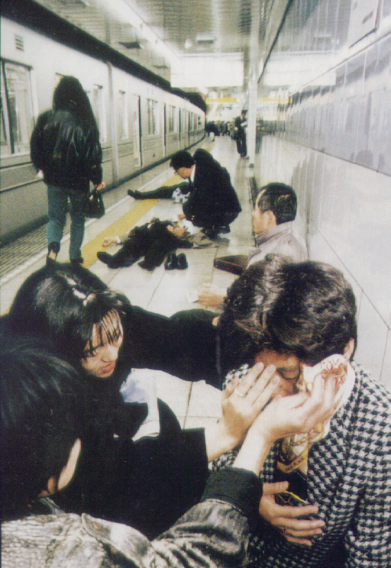
Case 1 – LIGHT RAIL INCIDENT
What is the this?
What is the risk?
What is the treatment?
Notes:
Tokyo subway terrorist attack in 1995, 12 died and 5500 sought care

Slide 59
Case 1 – cholinergic agents
Agriculture, pest control, and terrorism (nerve agent)
Contact, ingestion (suicide), vapor hazard
Constricted pupils, bronchorrhea, vomiting, seizures
Can be mistaken for narcotic od with pulmonary edema!
High risk to providers if any residual on patient/clothing/in vomit
Dry decon!
Control vomitus if ingestion (canister/bag)
SCBA primary, PAPR in low concentration areas (with organic vapor filter)
Notes:
Common uses in agriculture, pest control, and terrorism
Absorbed by contact, ingestion (most common in suicide attempt), vapor hazards

Slide 60
Case 1 – treatments
Treatment
Oxygen, usual seizure management
Endotracheal intubation preferred
Atropine 2mg at a time to control secretions
Administer Atropine drops sublingually if out of IV atropine
Mass casualty – activate CHEMPACK
Mark 1 kits – 2mg atropine, 600mg pralidoxime
2 kits per seriously ill patient – repeat atropine as needed
Atropens for pediatric – blue = baby, red = child < 5
Notes:
Common uses in agriculture, pest control, and terrorism
Absorbed by contact, ingestion (most common in suicide attempt), vapor hazards

Slide 61
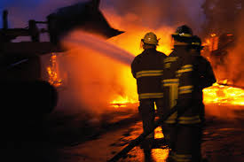
Case 2 – house fire
Victim found in bedroom
Initial shock, then VF arrest
What do you suspect?
How do you treat?

Slide 62
Case 2 – smoke toxicity
Simple asphyxiant – displaces oxygen in air
Treatment is oxygen!
Chemical asphyxiant – deprives body of usual use of oxygen
Cyanide (CN), Carbon Monoxide (CO)
Burning plastics generate CN
CO and CN should be suspected in any closed space smoke exposure

Slide 63
Case 2 – Treatment
Supportive Management
Suspect Acidosis – give BICARB x2
Cyanide Antidote Kit
Any unstable / VF arrest victim of closed space smoke exposure
5G dose (kit)
Carbon Monoxide
Hyperbaric Oxygen (also treats CN)
Notes:
Usual cardiac arrest management but give bicarb for acidosis, give CN antidote kit if available, consider transport to HBO facility (Hennepin)

Slide 64
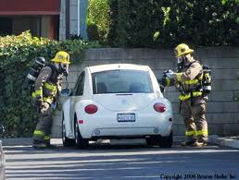
Case 3 - Slumper
Unresponsive female in car
Visible vapor inside
Open bucket in passenger seat
What are you worried about?
What should you do?

Slide 65
Case 3 – hydrogen sulfide
‘Sewer Gas’
Heavier than air – below grade sewer / cistern work / drilling
Rotten egg smell, but olfactory fatigue rapidly occurs
Highly toxic, ‘knock down’ gas
‘Bucket Suicide’ – toilet bowl cleaner and sulfur-containing insecticide mixed in small space

Slide 66
Case 3 – Treatment
Use SCBA – If not available, punch out windows and allow car to ventilate prior to accessing victim
Supportive care
Consider CN antidote kit if alive or VF
Notes:
Give CN antidote kit if available

Slide 67
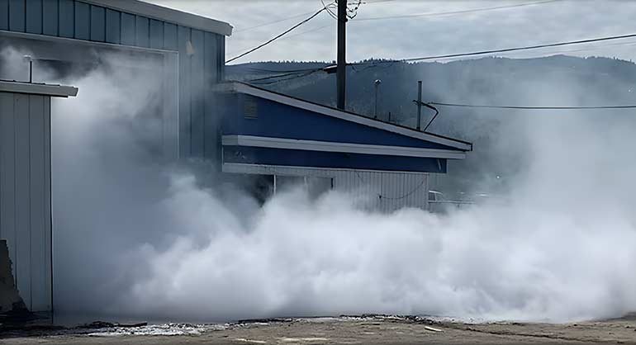
Case 4 – Cold Storage Tank Breach
Cold storage facility, tank breach
Multiple persons w/respiratory distress
What is this?
What is the treatment?
What are other considerations?

Slide 68
Case 4 – AMMONIA
Irritant gas
Very alkaline
Can cause severe eye, airway injury and frostbite (if close exposure)
Scene Considerations
Upwind
Prevent additional exposures
Fire Dept mitigation/control – water curtains, leak control
Consider dry decon

Slide 69
Case 4 – Treatment
Supportive care, intubation if required
Supraglottic airways may not work
Consider bicarb neb if mild stridor but otherwise doing okay
Scene Considerations
Safe area to stage! Upwind and uphill (heavier than air)
Evacuation of affected area
Notes:
Give CN antidote kit if available

Slide 70
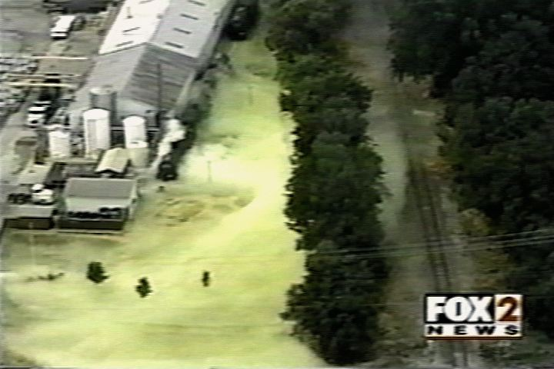
Case 5 – RAIL CAR Breach
Multiple persons coughing, choking
What is this?
What is the treatment?
What are other considerations?

Slide 71
Case 5 – Chlorine
Most common HAZMAT exposure causing injury
Yellow/green gas in large concentration
Moderately water soluble – upper and lower airway injury/edema
Upper – usually max in 1 hour
Lower – usually max in 4 hours
May require dry decon

Slide 72
Case 5 – Treatment
Supportive care, intubation if required
Supraglottic airways may not work
Consider bicarb neb if mild stridor but otherwise doing okay
Scene Considerations
Safe area to stage! Upwind and uphill (heavier than air)
Evacuation of affected area
Notes:
Give CN antidote kit if available

Slide 73
Metro Region Incident Response Plan
Metropolitan Emergency Services Board (MESB)

