Slide 1

MMRTAC
TQIP Collaborative
Spring Meeting
5/28/26
J Gipson

Slide 2

MMRTAC TQIP Collaborative Spring 2026
First TQIP report
Overview and Highlights
How did we do?
  Major Hospital Events
  Risk Adjusted Mortality
Next steps-
  Review the data
  Indentify opportunities PI project?
  Identify Strengths Poster Presentation?
Working meeting 5/28/26
TQIP Annual Meeting 11/13/26

Slide 3
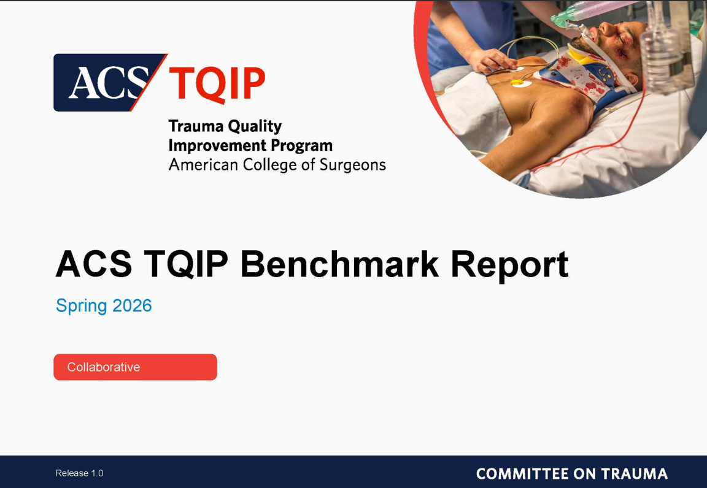
MMRTAC TQIP Collaborative

Slide 4
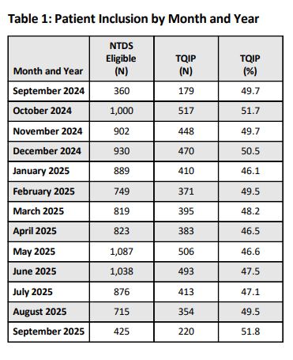
MMRTAC TQIP Collaborative

Slide 5
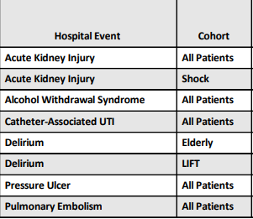
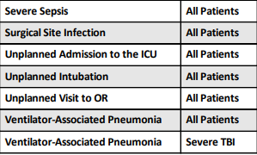
MMRTAC TQIP Collaborative

Slide 6
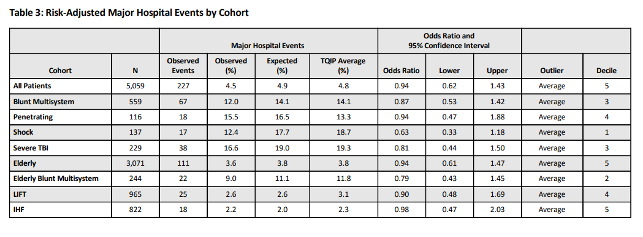
MMRTAC TQIP Collaborative

Slide 7
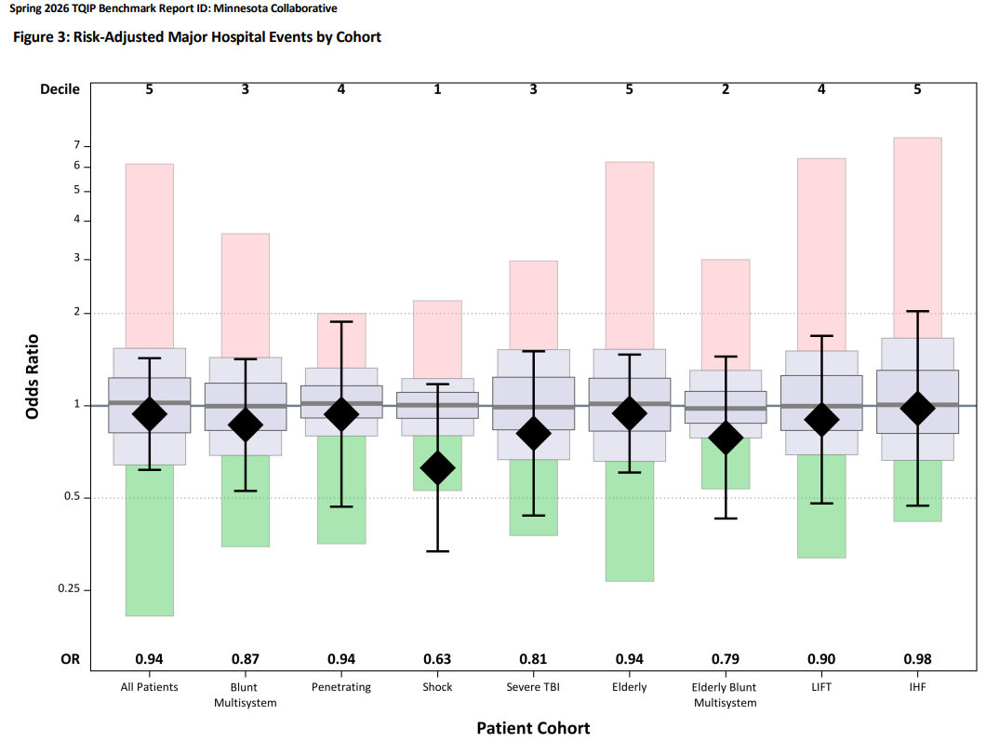
MMRTAC TQIP Collaborative

Slide 8
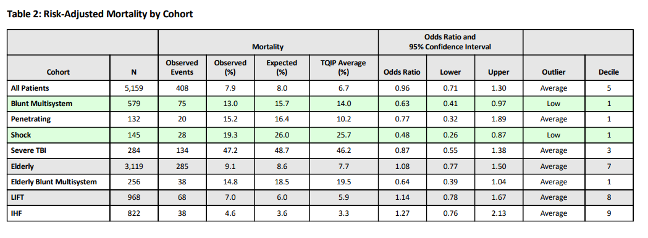
MMRTAC TQIP Collaborative

Slide 9
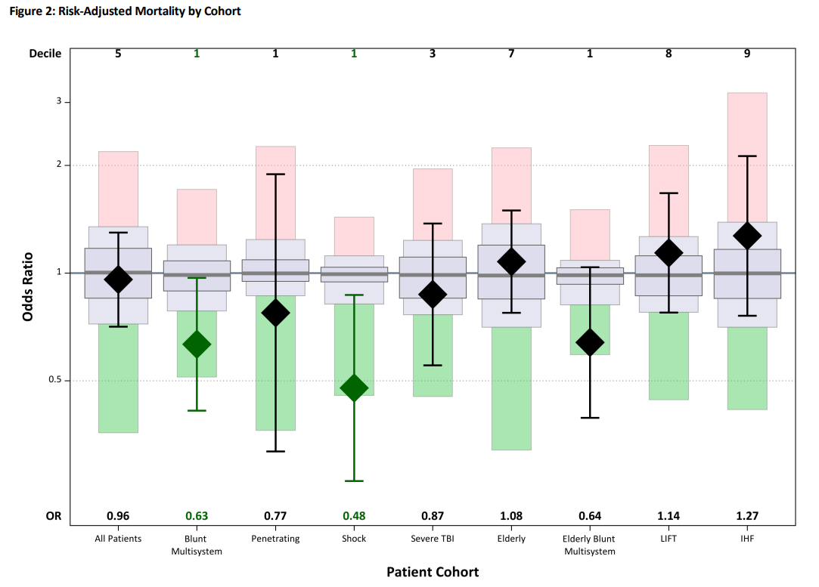
MMRTAC TQIP Collaborative

Slide 10
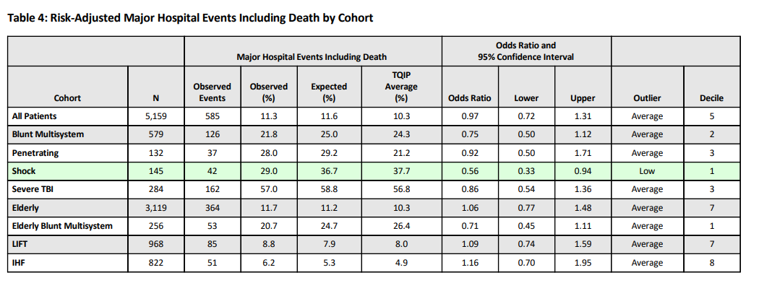
MMRTAC TQIP Collaborative

Slide 11
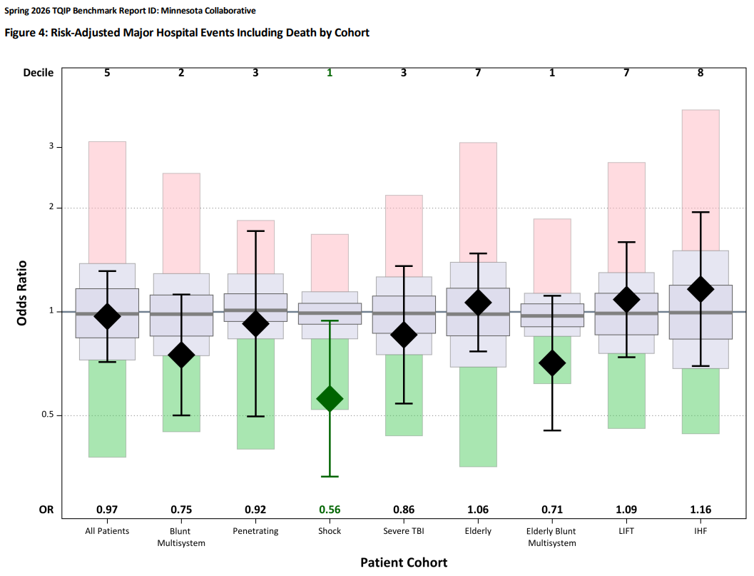
MMRTAC TQIP Collaborative

Slide 12
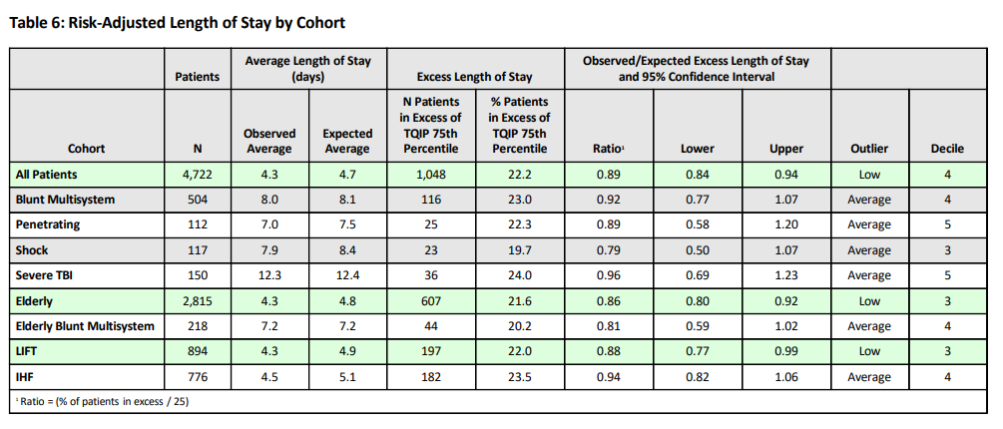
MMRTAC TQIP Collaborative

Slide 13
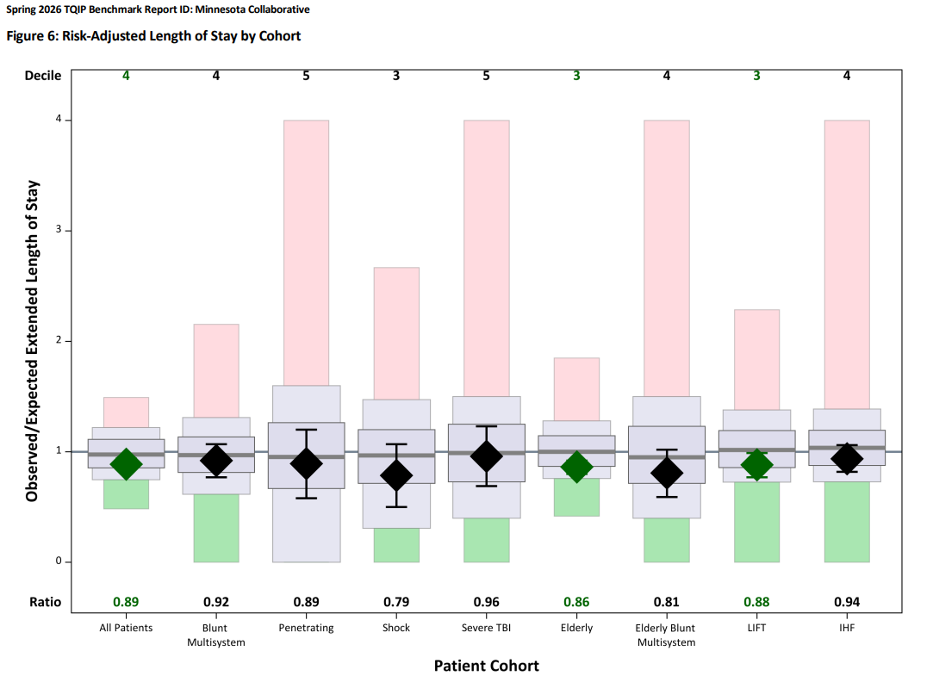
MMRTAC TQIP Collaborative

Slide 14
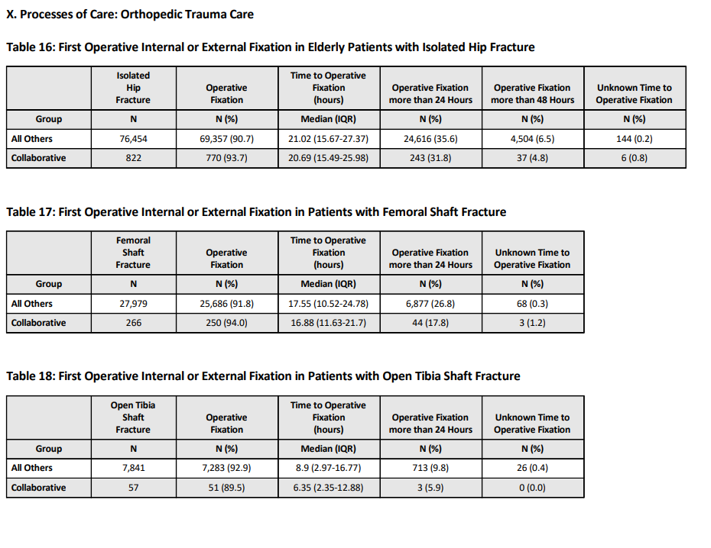
MMRTAC TQIP Collaborative

Slide 15
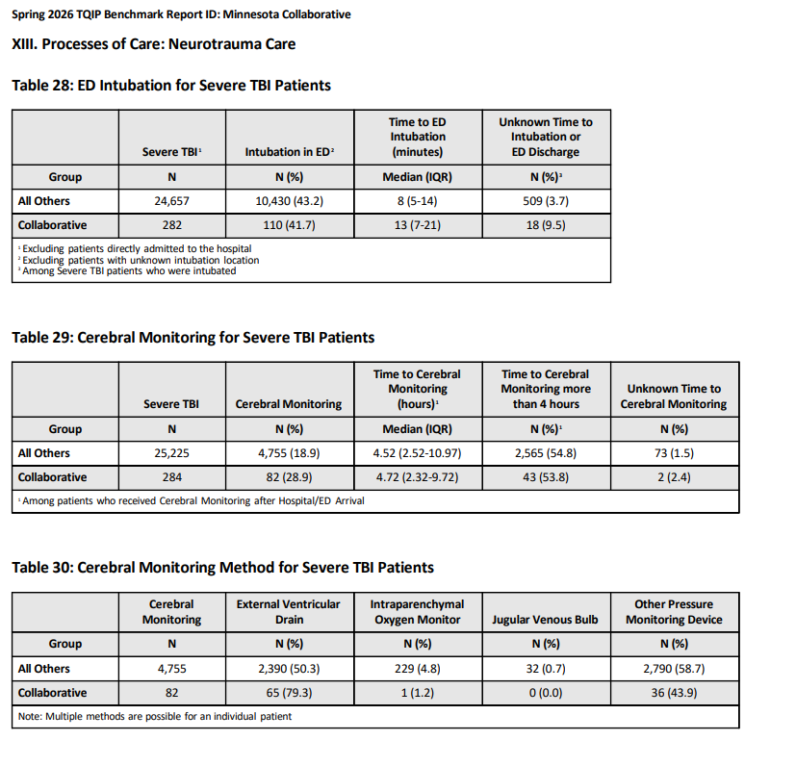
MMRTAC TQIP Collaborative

Slide 16
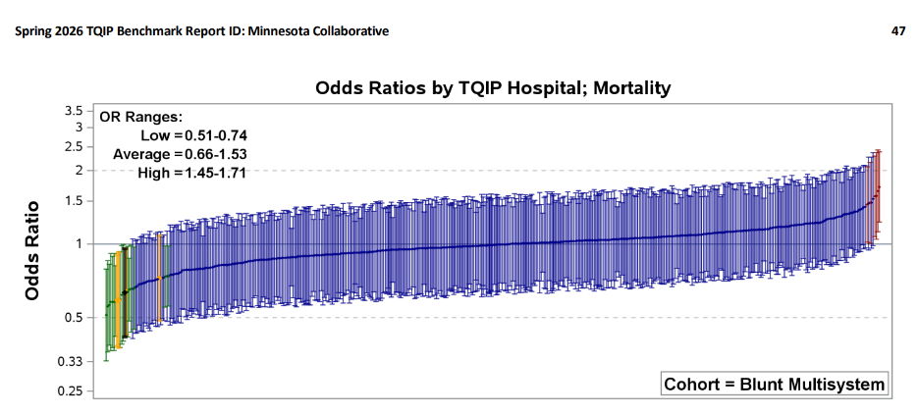
MMRTAC TQIP Collaborative

Slide 17
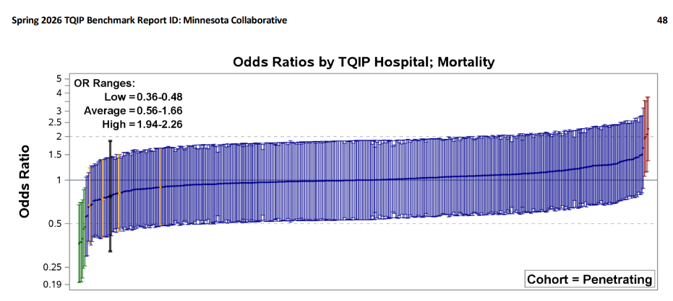
MMRTAC TQIP Collaborative

Slide 18
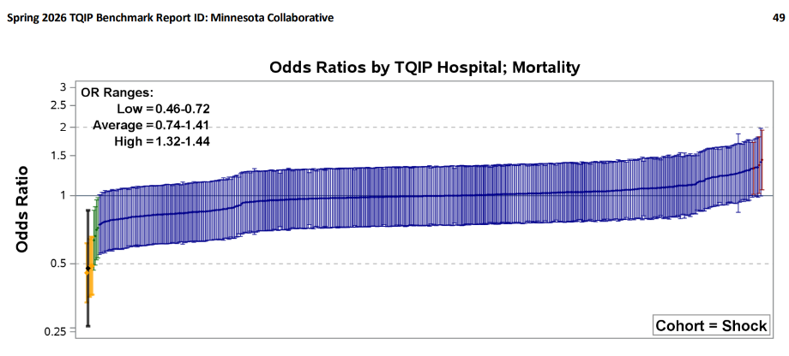
MMRTAC TQIP Collaborative

Slide 19

MMRTAC TQIP COLLABORATIVE

