Slide 1

MMRTAC
TQIP Updates
Fall Meeting
11/20/25
J Gipson

Slide 2
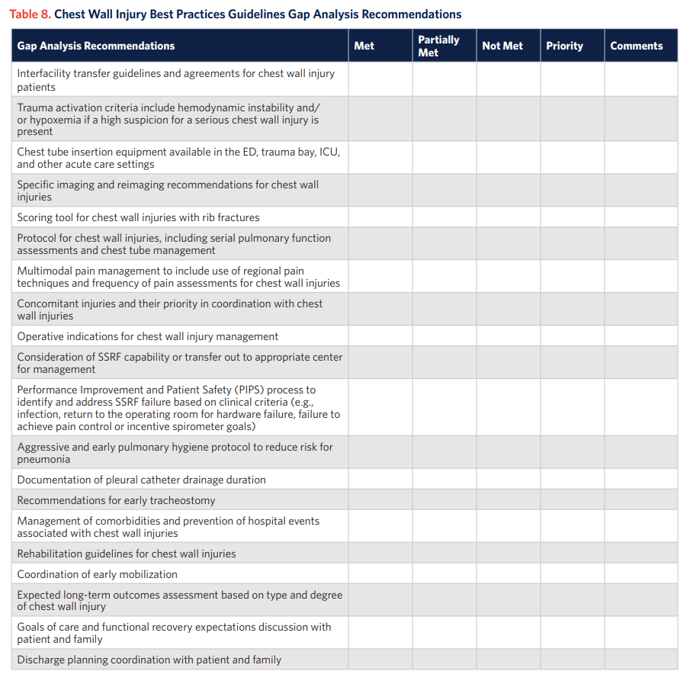
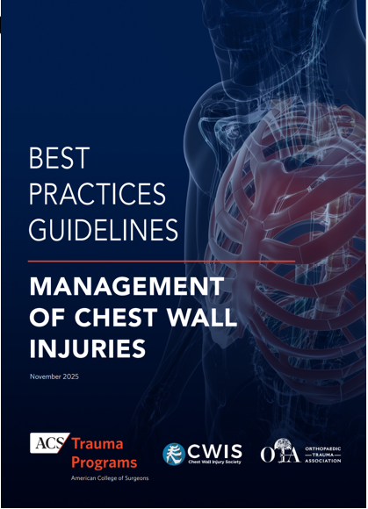


TQIP 2025 Updates

Slide 3

TQIP 2025 Updates
933 TQIP Trauma centers
2100 attendees
400 + posters
25 break out presentations

Slide 4
TQIP 2025 Updates
How to Build Teams
Registry, Leadership tracks
Survivor Sessions
Change in definitions
  Unplanned OR
New ACS TQP Best Practices Guidelines | ACS
  Chest Well Injury
  Urogenital Injury
    Gap Analysis tool

Slide 5
TQIP 2025 Updates
How to Build Teams
Registry, Leadership tracks
Survivor Sessions
Change in definitions
  Unplanned OR
New ACS TQP Best Practices Guidelines | ACS
  Blunt Chest Injury
  Urogenital Injury
    Gap Analysis tool

Slide 6
TQIP 2025 Updates
Chest Wall Anatomy, Physiology
Assessment and disposition
  Floor , ICU, Home
Pain Management
  Multimodal
Operative management
  Rib fracture
  Sternal fracture
Postoperative Care
  Pullmonary function

Slide 7
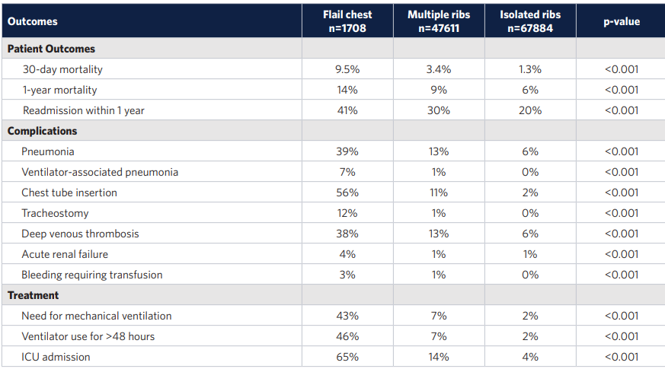
TQIP 2025 Updates

Slide 8
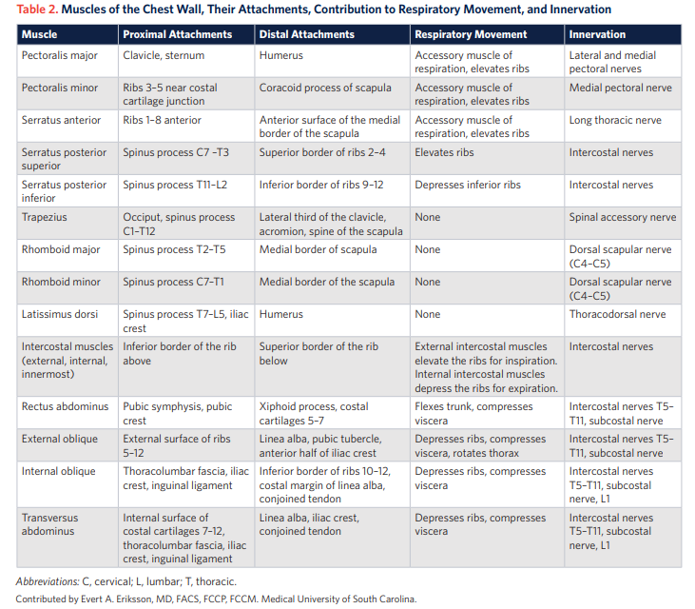
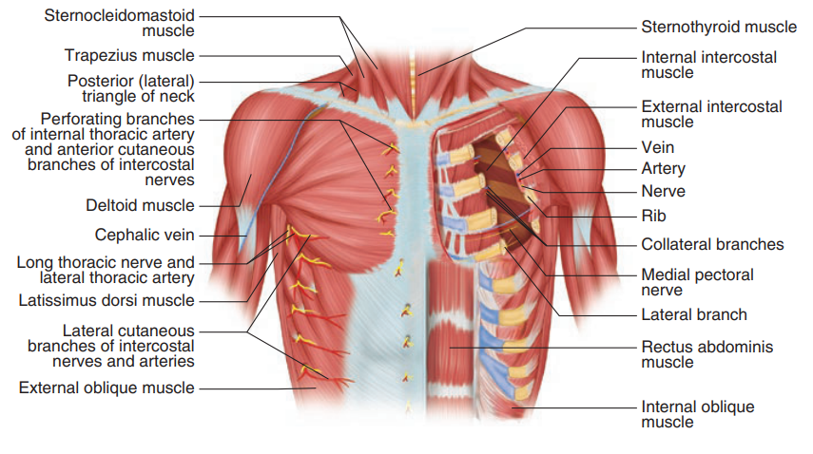
TQIP 2025 Updates

Slide 9
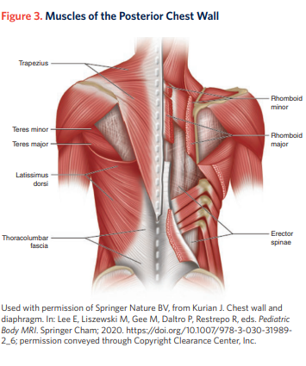
TQIP 2025 Updates

Slide 10
TQIP 2025 Updates
Patterns of Trauma
Increase mortality with
  Age
  Number of rib fractures
    1.1 OR per rib
  Flail Chest

Slide 11
TQIP 2025 Updates
Patterns of Trauma
ISS > 16 44.9% “Polytrauma”
1st Rib Fractures
  28.9% TBI
  6.6% C spine Fractures
  2.3 % Intrathoracic Vascular injuries

Slide 12
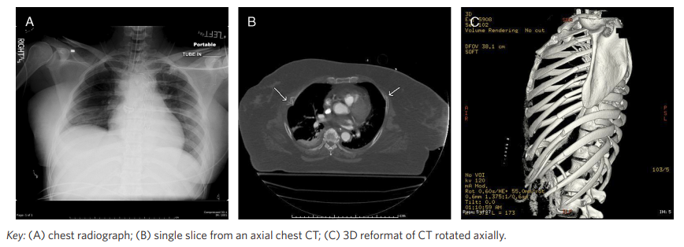
TQIP 2025 Updates- Preop Planing
postop

Slide 13
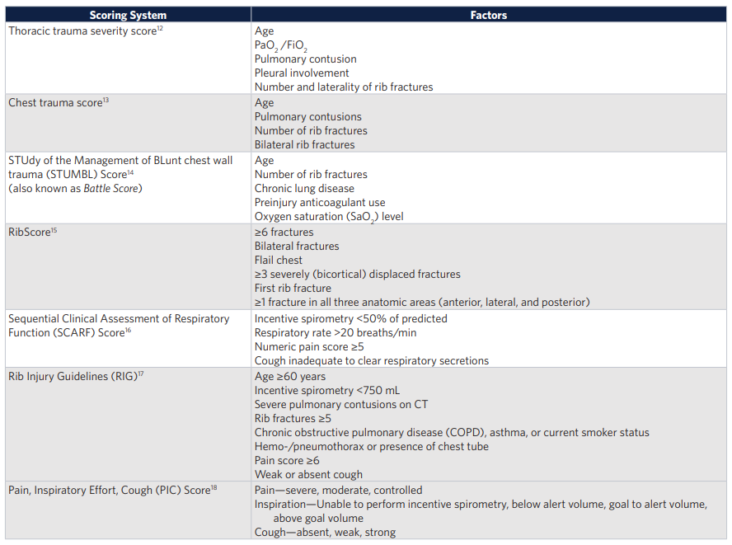
TQIP 2025 Updates

Slide 14
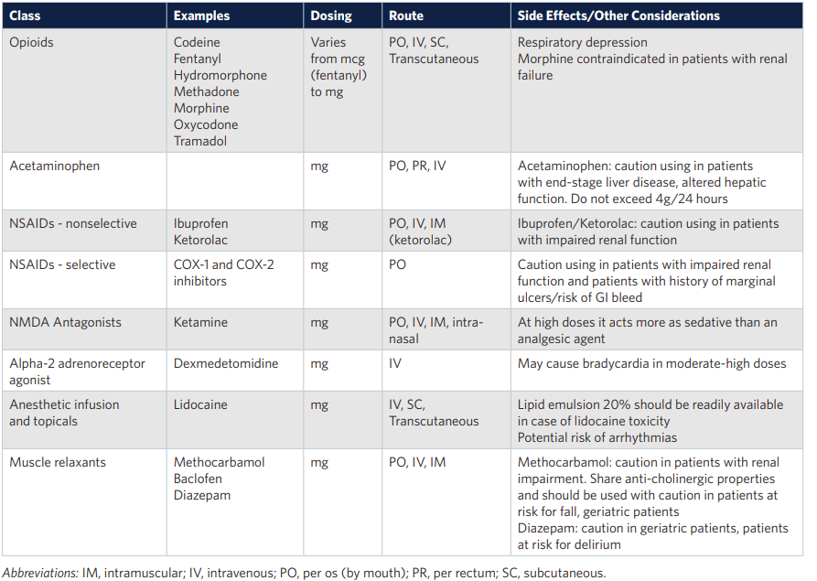
TQIP 2025 Updates – Pain Management

Slide 15
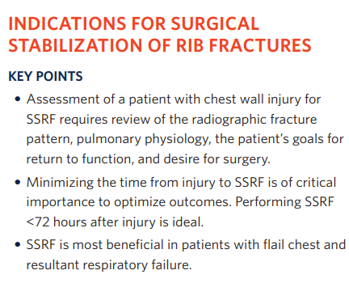
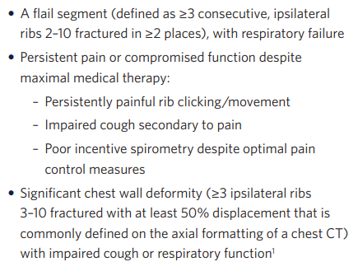
TQIP 2025 Updates- Indications Rib Fixation

Slide 16
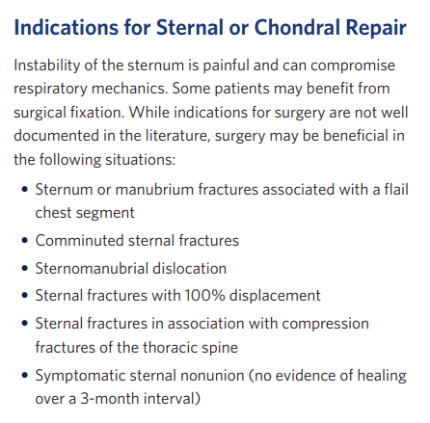
TQIP 2025 Updates

Slide 17
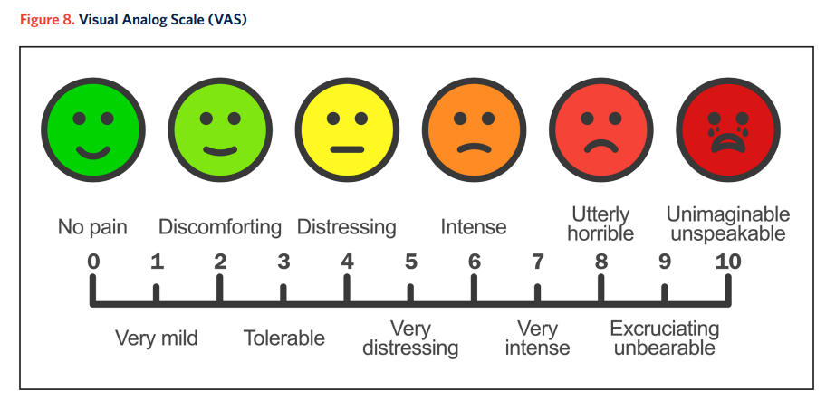
TQIP 2025 Updates
Complications Rib fix
Postoperative Care
Follow Up
Outcomes Measurements

Slide 18
TQIP 2025 Updates

Slide 19

TQIP 2025 Updates

Slide 20
TQIP 2025 Updates
Initial Assessment GU
Initial Imaging
Renal
  Non-op, angiography
  Operative
Bladder – Operative
  ortho consideration
Urethral Injury –
  OR vs stents
  Pelvic Fx
Genitalia
  bites
  peds

Slide 21
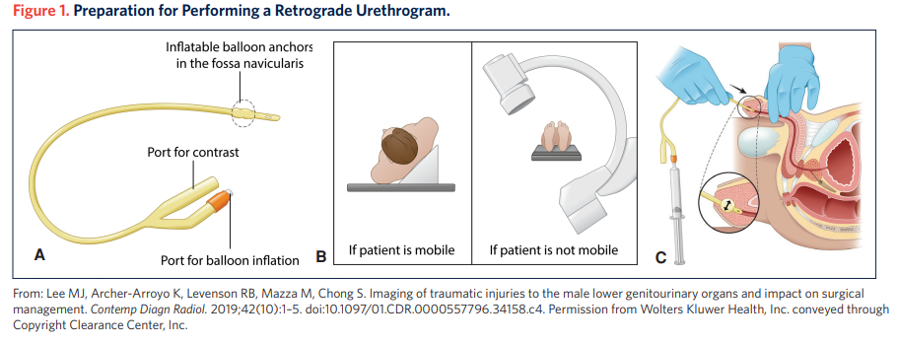
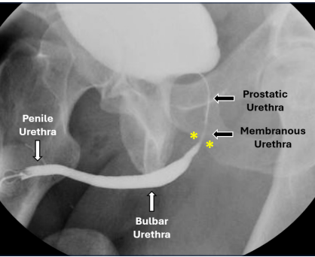
TQIP 2025 Updates

Slide 22
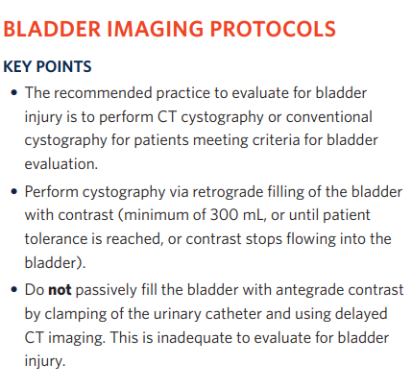
TQIP 2025 Updates

Slide 23
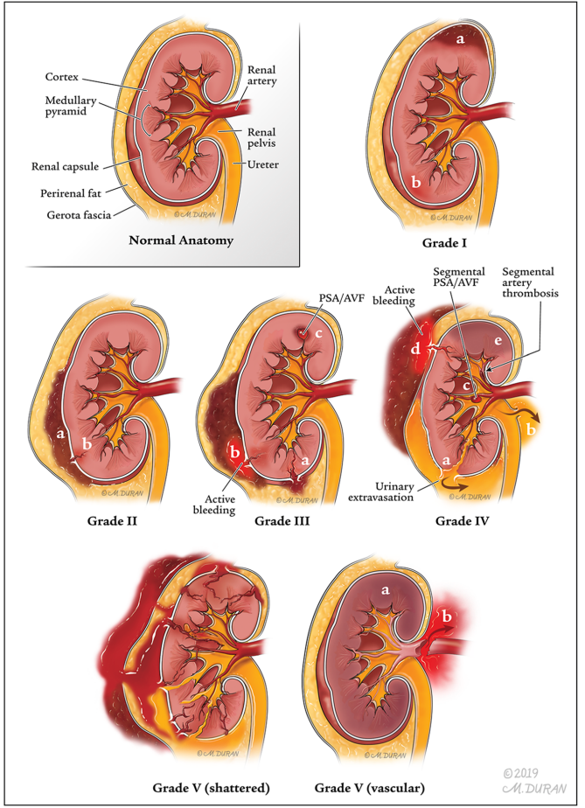
TQIP 2025 Updates

Slide 24
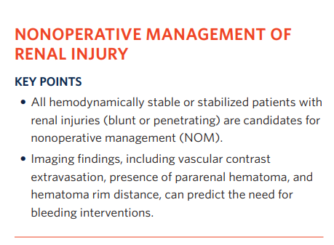
TQIP 2025 Updates- Management non-op

Slide 25
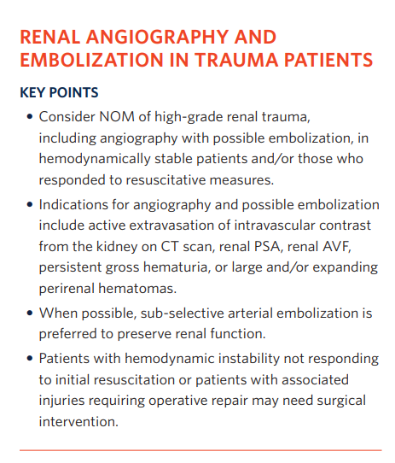
TQIP 2025 Updates

Slide 26
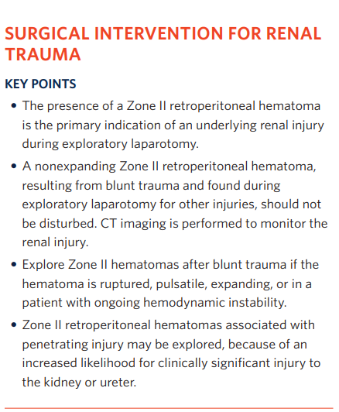
TQIP 2025 Updates Management Operative

Slide 27
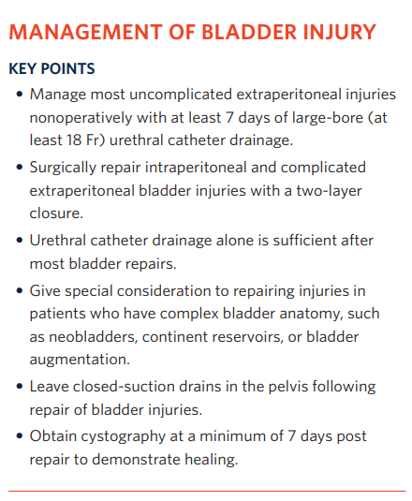
TQIP 2025 Updates- Renal/Bladder/Urethral/Genitalia

Slide 28
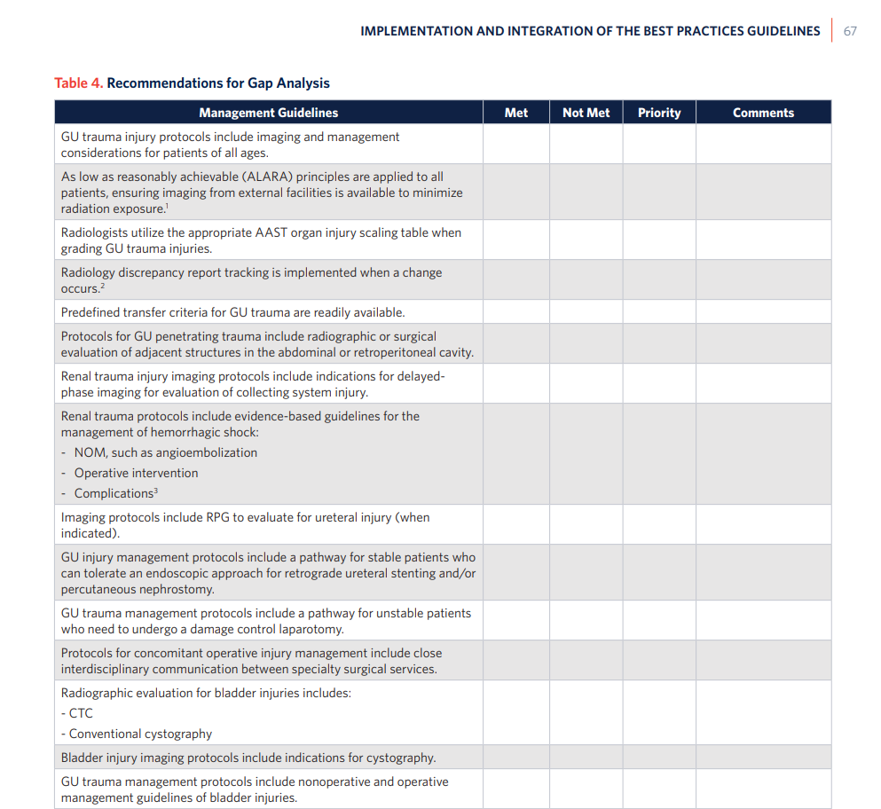
TQIP 2025 Updates

Slide 29
2025 – MMRTAC TQIP COLLABORATIVE
What Is a TQIP Collaborative?
A group of Trauma Quality Improvement Program (TQIP) hospitals in specified geographic area working together with the shared goal of trauma system quality improvement.

Slide 30

MMRTAC TQIP COLLABORATIVE
Spring Report 2026-
Consideration Gap Analysis CW or GU Trauma?
Other 2026 Projects?
Poster Presentations for 2026 Meeting- What are we proud of in Minnesota?

Slide 31

STAC updates

